Slide 1
History 1301 U.S. History to 1877
Slide Set 5
Central Texas College
Fort Knox, Kentucky
Bruce A. McKain

Slide 2
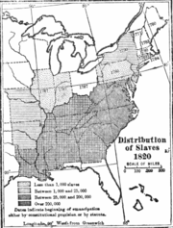
Divergent Societies
Life in the South
  Planter Class - 50 or more slaves
  Yeoman Farmers - few slaves
  Poor Whites – no slaves
  Slaves – 200,000 free blacks by 1850 (+/- 6%), 11,000,000 slaves in 1860.
Slave Owners
  76.1% -non-slave owners
  17.9% -1-9 slaves
  6.6% - 10-99 slaves
  0.1% - 100+ slaves

Slide 3
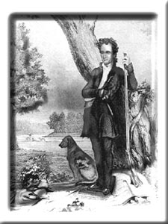
The Texas Question
A state in the Republic of Mexico since 1822.
U.S. offer to buy is refused.
Mexico invites settlers, by 1835 35,000 “Gringos” live in Texas
Stephen Austin a leader in settlement movement.
Texas declares independence in 1836.

Slide 4
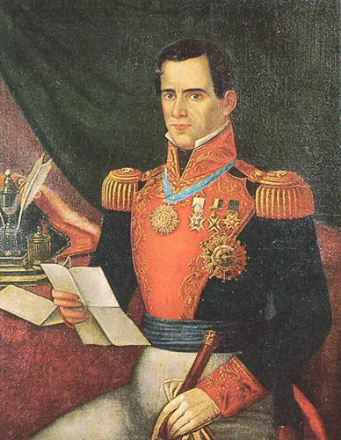
The Texas Question
President/ General Santa Anna marches into Texas to put down the revolt.
Texas Army under command of Sam Houston ill equipped and ill trained, Houston orders garrison at San Antonio to delay Santa Anna.

Slide 5
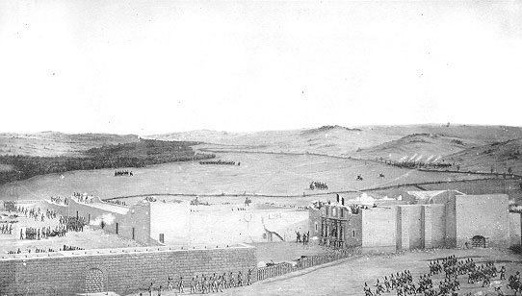
The Alamo
The garrison at the Alamo (outside San Antonio) fights and delays Santa Anna for 10 days before falling on 6 March 1836, just four days after Texas formally declared independence.

Slide 6
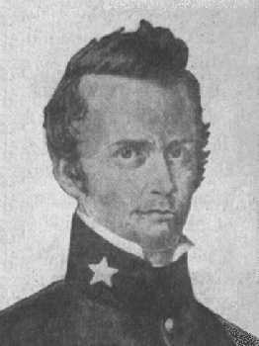
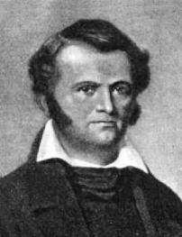
The Alamo Colonels
William B. Travis
Jim Bowie

Slide 7
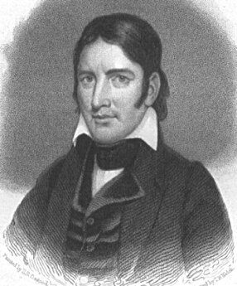
The Alamo Colonels
Davy Crockett
The Command
William Travis commanded Army of Texas regular troops.
Jim Bowie commanded Texas militia.
Davy Crockett led a force of frontiersman volunteers, mostly from Kentucky and Tennessee.
Total Force - 187 men.

Slide 8
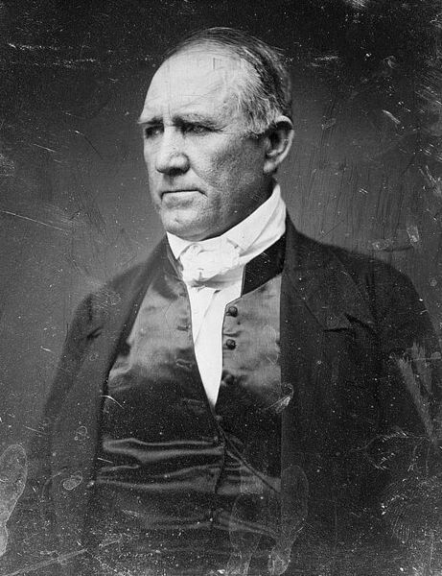
The Rest of the War
The War
General Sam Houston
“Remember the Alamo” becomes the rally cry for Texas.
Santa Anna continues to march into Texas.
23 April 1836 the Mexican army is trapped at San Jacinto and Santa Anna is forced to recognize Texas independence.
Texas applies for statehood but is denied for a time.

Slide 9
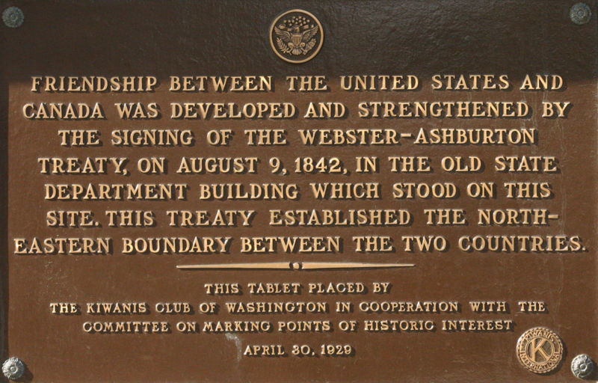
Conflict of the Period
U.S. vs. Canada
  Aroostook War 1837 confrontation over road through disputed territory, Maine militia, bloodless.
  Caroline Affair 1837 U.S. ship burned by Canadian loyalist.
  Creole Incident Britain declines to return escaped slaves and ship.
  Webster-Ashburton Treaty 1842 settled boundary dispute, and set spirit of cooperation between U.S. and Canada.

Slide 10
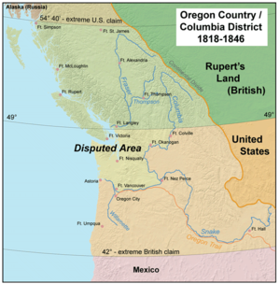
Settlement of Oregon
Major issue of 1844 election.
Bounded by Rockies to East, Pacific in West, 42 degrees North latitude in South and 54 degrees 40 minutes (Russian Alaska) in the North.
Joint occupation with Britain since 1818.
Polk did not desire war with Britain
Oregon Treaty set boundary at 49 degrees North latitude.

Slide 11
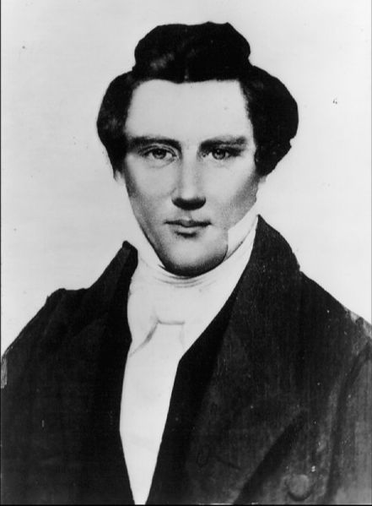
Mormon Migration
Joseph Smith founded religion in 1820s in Palmyra New York.
Forced to migrate eventually to Nauvoo, Illinois.
1844 Smith and his brother were jailed and was killed by amob.

Slide 12
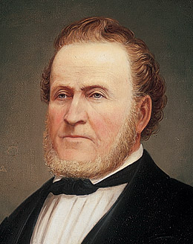
Mormon Migration
Brigham Young led migration to Utah.
85,000 migrants trekked to Great Salt Lake in 1846.
Mormons founded the Mormon Republic of Deseret.

Slide 13
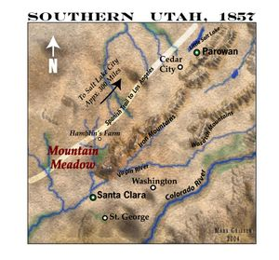
Mormon War
1857-58
Federal government sends troops to curb the “rebellion”.
Fierce fighting between Mormon forces and Federal troops at Mountain Meadows in 1857.

Slide 14
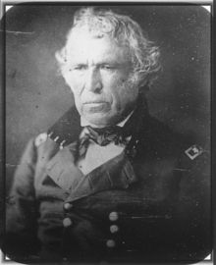
War with Mexico
Continued to encroachment of Americans into Mexican territory.
Texas boundary dispute.
Seizure of California by U.S. Naval forces in 1842.
1845 U.S. attempt to negotiate a settlement.
5 April 1846 U.S. Army troops attacked by Mexican force in disputed territory. War declared 13 May 1846.

Slide 15

War with Mexico
Strategy
  Land movement through New Mexico into California.
  Sea movement into California.
  Land movement against Mexico.
Kearney and Fremont take New Mexico and California as part of the Bear Flag Revolt.
General Zachary Taylor invades Mexico from the North.
Mexicans refuse to negotiate.

Slide 16
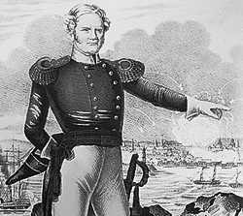
War with Mexico
General Winfield Scott lands the 1st U.S. Army amphibious assault at Veracruz- captures city with only 20 American lives lost and takes Mexico City by 13 September 1847.

Slide 17
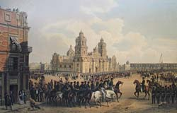
War with Mexico
Negotiated peace with the Treaty of Guadalupe-Hidalgo, 2 February 1848.
U.S. gains California, Mexican Northwest, and disputed territory in Texas for $15,000,000 and assumption of $3,250,000 in American claims against Mexico.

Slide 18
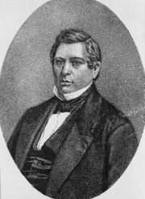
After the War
Wilmot Proviso – forbidding spread of slavery to free territory.
Congressman David Wilmot.

Slide 19
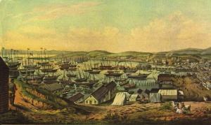
GOLD!
Gold discovered in California 24 Jan 1848 at Sutter’s Mill.
49ers Rush to California.
September 1849 California request statehood.

Slide 20
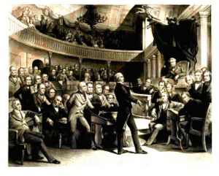
Compromise of 1850
California Issue.
Henry Clay
Daniel Webster
Stephen A. Douglas
  Debate and finally come up with a compromise that all parties can live with. Slavery issue to be decided by popular vote of territory population.

Slide 21
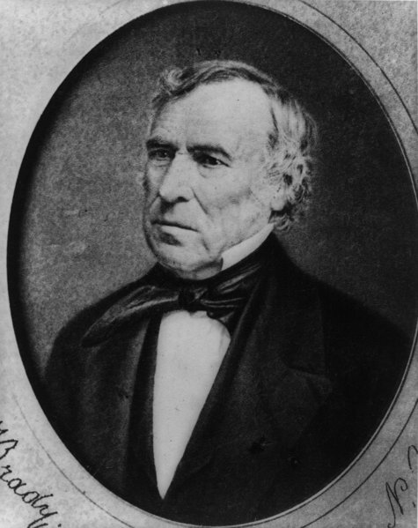
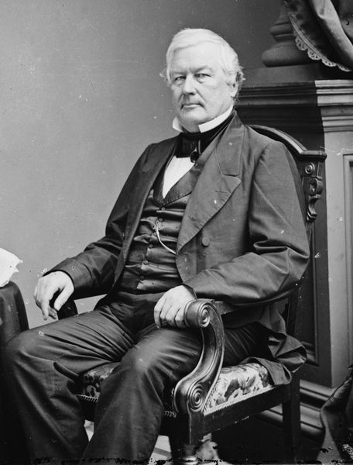
President Dies
President Zachary Taylor
President Millard Fillmore

Slide 22
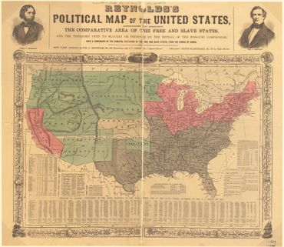
The Turbulent 50s
Texas/New Mexico land dispute goes to Texas.
Territories use popular sovereignty to determine slave status.
Slave trade abolished in Washington D.C.
Tougher Fugitive Slave laws.
Federal Government to pay Texas per-annexation debt.
Congress would not abolish slavery in Washington D.C.

Slide 23
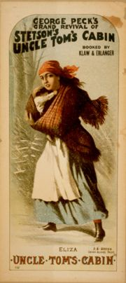
Road to War
Harriet Beecher Stowe writes Uncle Tom’s Cabin and makes slavery an everyday issue.
Kansas-Nebraska Act Passed.

Slide 24
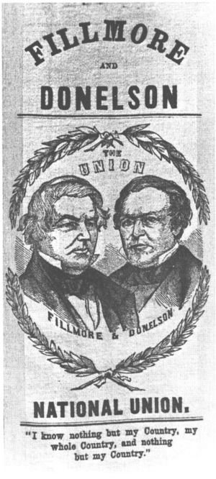
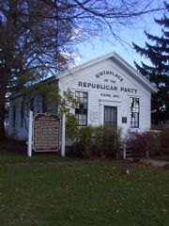
Road to War
American “Know Nothing” Party
Republican Party (1854)

Slide 25
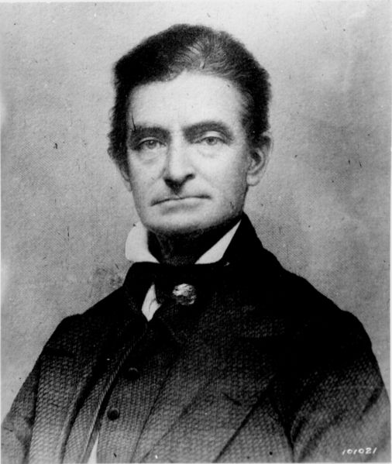
Bleeding Kansas
Popular Sovereignty Election Compromised by outside voters.
Two governments in territory.
May 1856 Lawrence Kansas sacked and burned by pro-slavers.
John Brown raids Pottawatomie Creek two days later in retaliation.
200 die in Kansas violence.

Slide 26
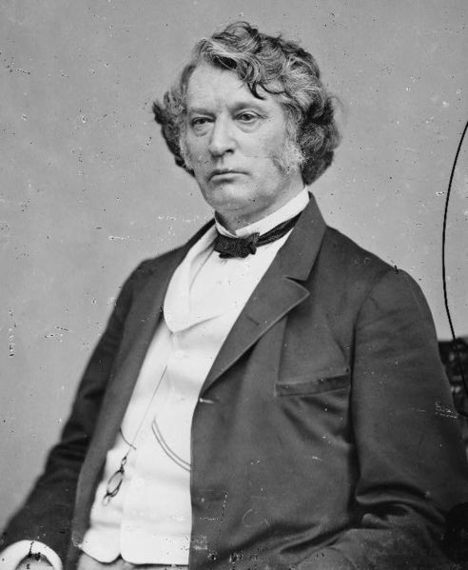
Violence in Congress
Senator Charles Sumner’s two day speech “The Crime Against Kansas” insults Senator Andrew Butler.
Congressman Preston Brooks attacks and beats Sumner on floor of Senate in retaliation.

Slide 27
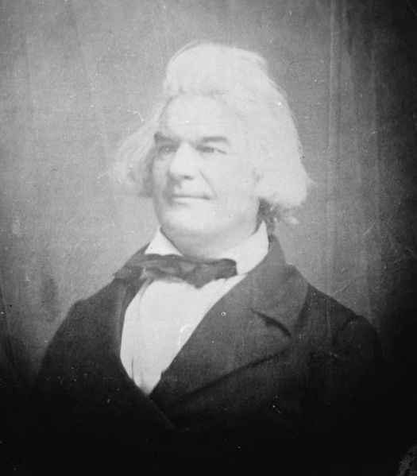
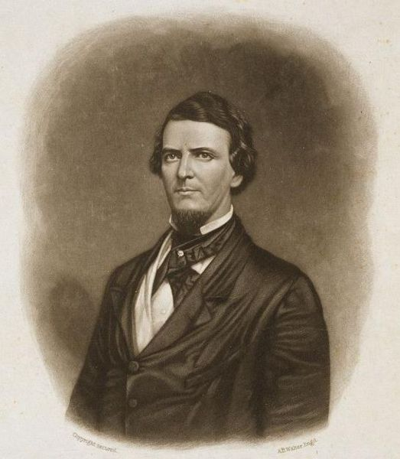
Violence in Congress
Senator Andrew Butler
Congressman Preston Brooks

Slide 28
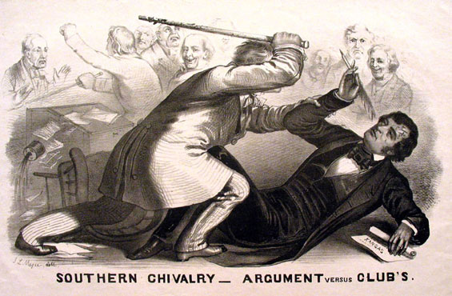
Violence in Congress

Slide 29
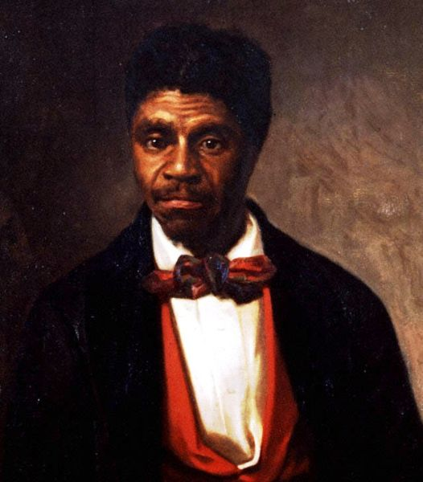
Road to War
Dred Scott case – Supreme Court decides not to decide.

Slide 30
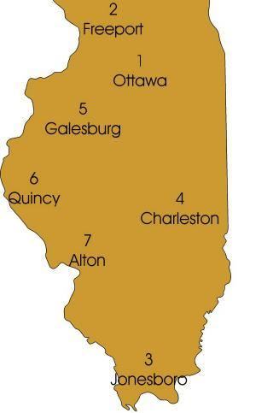
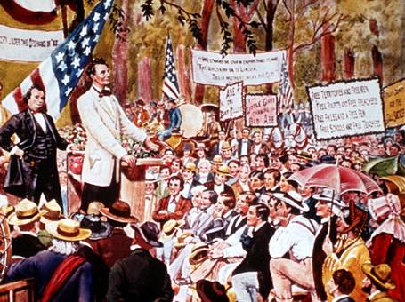
Lincoln Douglas Debates

Slide 31
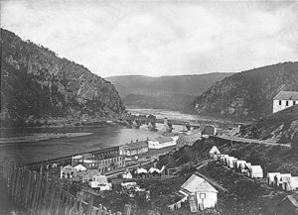
John Brown’s Raid
16 October 1859
Harper’s Ferry Virginia
U.S. Marines under command of Colonel Robert E. Lee captures John Brown.

Slide 32
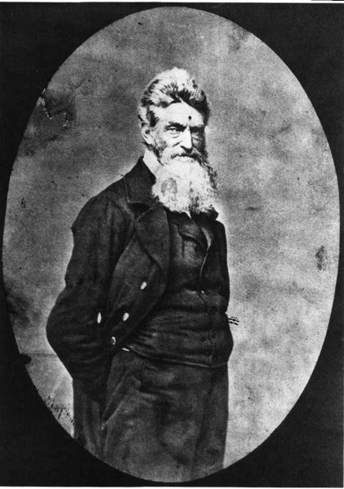
John Brown’s Trial
John Brown is tried, convicted and hanged on 2 December 1859.

Slide 33
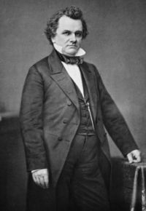
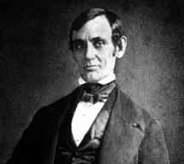
Election of 1860
Stephen A. Douglas
Northern Democrat
Abraham Lincoln
Republican

Slide 34
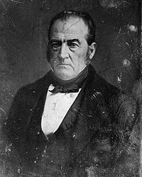
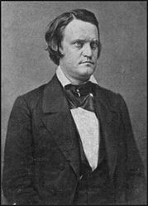
Election of 1860
John Bell
Constitutional Union Party
John Breckinridge
Southern Democrat

Slide 35
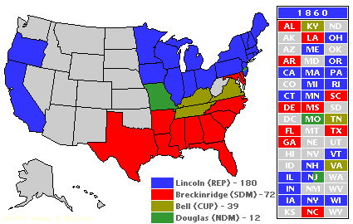
Election of 1860

Slide 36
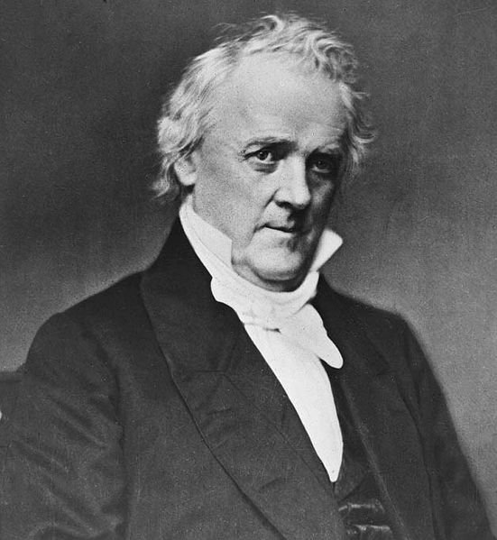
Road to War
After the election President Buchanan fails to take any actions to keep Southern states from leaving the Union. This four month delay make the war almost inevitable.

