Slide 1
The Rise of Nationalism in late 19th Century Europe – Chapter 22
Central Texas College
Fort Knox Kentucky
Bruce A. McKain

Slide 2
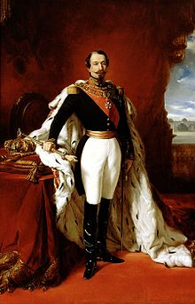
French Nationalism
Charles Louis Napoleon Bonaparte, (aka) Napoleon the Small, Napoleon III
Ist President of the French Republic, elected 1848, initiated a coup d’etat in 1851.
Emperor of the Second French Empire 1852 to 1870.
Nephew of Napoleon Bonaparte.

Slide 3
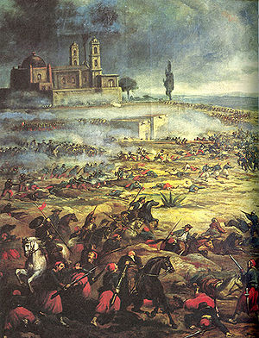
French Nationalism
Energetic Foreign Policy
  War with Austria 1859
  Spearheaded Allied Action against Russia in Crimean War
  French Garrison in Rome to protect Papal States from Italian annexation
  French rule in Cochinchina and New Caledonia
  Upheld French interest in the Second Opium War and the Taiping Rebellion in China
  French intervention in Mexico, aborted in 1867

Slide 4
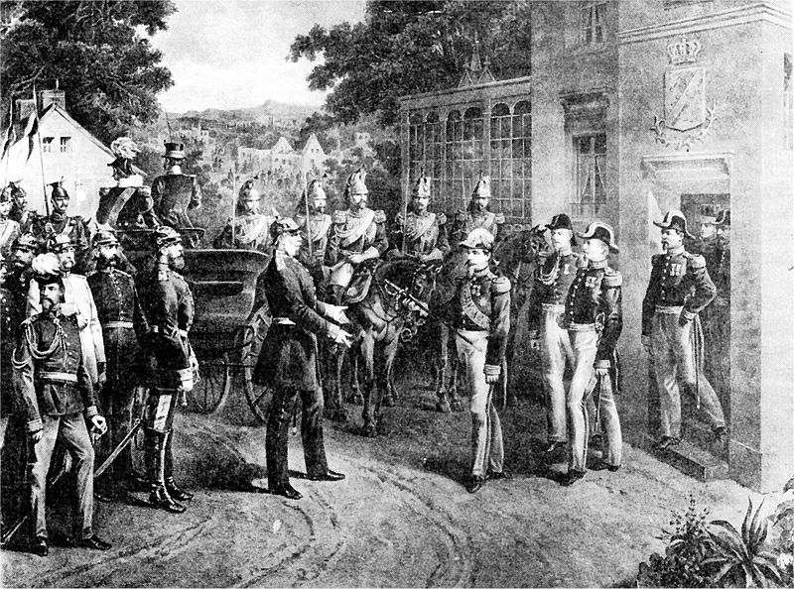
French Nationalism
Major Period of French Industrialism
Major renovation of Paris during this period
Second Empire overthrown three days after Napoleon’s surrender at the Battle of Sedan, 1870.
Third French Republic formed and cession of Alsace-Lorraine to German Empire.

Slide 5
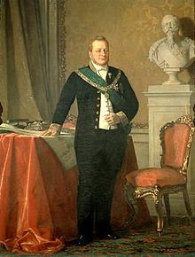
Italian Nationalism
Camillo Benso, Count of Cavour
Leading figure in movement toward Italian unification
Founder Italian Liberal Party
Prime Minister of Piedmont-Sardinia

Slide 6
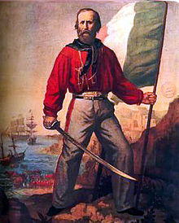
Italian Nationalism
Giuseppe Garibaldi (1807-82)
Joined Carbonari Italian Patriot Revolutionaries, while in his twenties
Revolutionary in South America leading the Italian Legion
Returned to Italy in 1848

Slide 7
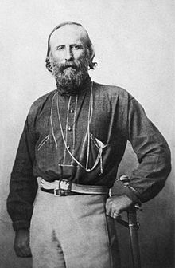
Italian Nationalism
Led forces for Lombardy in First Italian War of Independence, winning victories at Luino and Morazzone.
Moved to Rome after defeat of Piedmontese in 1849 to support Papal States against Louis Napoleon’s forces.

Slide 8
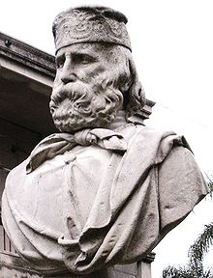
Italian Nationalism
June 1849 Garibaldi withdrew from Rome with 4,000 troops.
After his following fell to 250 men he was forced to emigrate again to Tangier.
Returned to Italy in 1854.

Slide 9
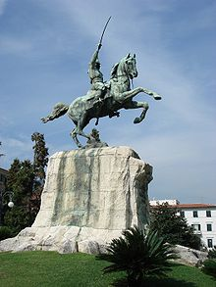
Italian Nationalism
1859 Second Italian War of Independence
Led “Hunter of the Alps”
Won victories at Varese and Como over the Austrians
1860 led I mille (the thousand) often known as the Red Shirts to victory in Sicily

Slide 10
Italian Nationalism
Garibaldi crossed the straits to Italy and moved North taking Naples 7 September 1860
30 September defeats the Neapolitan army.
Turns territorial gains to the Piedmontese after meeting with Victor Emmanuel II, and goes into temporary retirement
He continued to fight over the next ten years, eventually being elected to Italian Parliament.

Slide 11
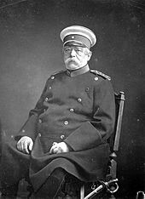
German Nationalism
Otto Eduard Leopold, Prince of Bismarck, Duke of Lauenburg (1815-1898)
Oversaw unification of Germany
1st Chancellor of the German Empire
Removed from office in 1890 by Kaiser Wilhelm II
Led Prussian Army to victory over France in 1871

Slide 12
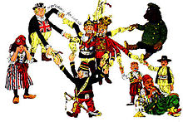
German Nationalism
After French defeat Bismarck negotiated with Southern German state to effect unification
Led the anti-catholic Kulturkampf
1878 Anti-Socialist Laws
Spent great deal of time insuring a “Balance of Power”

Slide 13
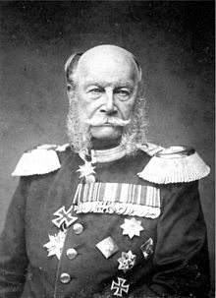
German Nationalism
Wilhelm Friedrich Ludwig von Freussen
Reign 1861-88
Fought against Napoleon Boneparte
As second son was not expected to rule
Possibly the Greatest of the “German” Emperors

Slide 14
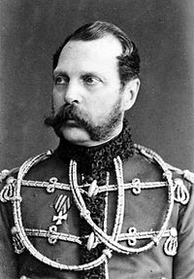
Russian Nationalism
Russian defeat in Crimean War showed weakness of absolute monarchy
Abolished Serfdom March 3 1863
Peasants had to repay state for cost of their land.
Established Local Assemblies “Zemstvos”

Slide 15
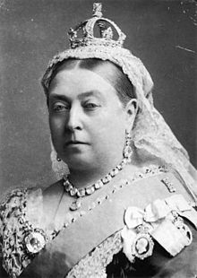
Victorian England
Alexandrina Victoria 1819-1901, ruled 1837-1901 (63 years 7 mo)
Empress of India 1876 to 1901
Grandmother of Europe , 9 children, 34 grandchildren
In mourning for 41 years

Slide 16
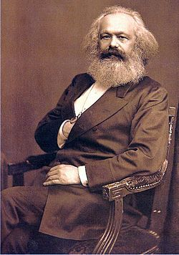
Marx and Marxism
German philosopher, sociologist, economic historian, journalist, and revolutionary socialist
Communist Manifesto 1848
Capital 1867-94
Friedrich Engels

