Slide 1
FISH – Following Instructions, A Successful Habit
Jenny Shotwell
Ellen Falkenstein

Slide 2
FISH Outline
Padlet (A Collaboration Tool)
Learning Catalytics (Clicker on Steriods)
Why We Started FISH
Written/Verbal Instructions

Slide 3
Padlet
Great resource for reading/writing to create group projects.

Slide 4
Padlet Demonstration
Come up to podium
Type in email address to receive the link in Padlet
Click on the link in the email https://padlet.com/ellen_falkenste/gyphzrgscf1l
Click anywhere on the screen to get an input box – type a message or upload a photo

Slide 5
Padlet Class Assignment
Sample Assignments:
Use google to search for a picture or take a picture of a function
Find a real world example for logarithms – post picture or description
Conduct a scavenger hunt on campus (students load pics)

Slide 6
Padlet Assignment - Instructions
The assignment was emailed to the students and given
on paper. The assignment was on blue paper so the team
knows to not help the students – the point is for them to
figure it out!!

Slide 7
Padlet Assignment – Group Page

Slide 8
Padlet Assignment - Examples
Absolute Value
Function

Slide 9
Padlet Assignment - Examples

Slide 10
Learning Catalytics

Slide 11
Learning Catalytics Demo
www.learningcatalytics.com/demo
Enter First Name, Last Name, email address, agree to Privacy Policy, Start
Enter a class session ID to join a session (Enter XXXXXXX and Join)
Click on Show Seat Map, click on your seat, OK
You can begin on the first problem

Slide 12
Learning Catalytics Features
Scores can be loaded in the MyLabsPlus Gradebook
Instructor is able to vary the percent for correctness versus the percent for participation

Slide 13
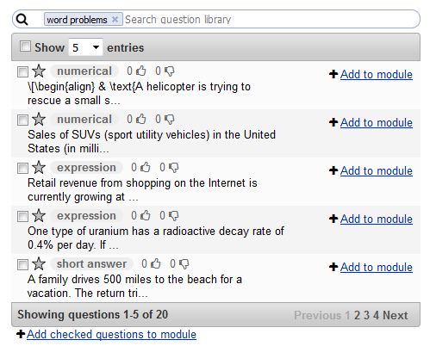
Learning Catalytics Features
Instructor can load questions from a subject library or create new questions

Slide 14
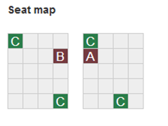
Learning Catalytics Features
The room map allows instructor to see who answers (correctly or incorrectly)
“I don’t understand” button
Software can put students into groups to discuss the problem using the map

Slide 15
Learning Catalytics Features
Pacing for the problems:
Instructor-Led Synchronous (in class)
Automated Synchronous (outside of class)
Self-Paced (answer in any order)
Self-Test (receive feedback)
Team-Based Assessment

Slide 16
Learning Catalytics
The students enjoy:
The anonymous competitiveness
The teasing from me when I don’t see the answers I need
The group discussion
The break from a normal lecture
Plan to use for mini-quizzes next semester.

Slide 17

Moving on…
Padlet and Learning Catalytics are just two of the tools we use for the FISH (Following Instructions, A Successful Habit) program.
Laughing-lion-design.com

Slide 18

Why We Use the Term FISH
Lifehacker.com
The author Matthew Kelly was the first to write this quote and attribute the quote to Einstein.
There is no evidence that Einstein actually said this; however, the quotation was based on ideas
circulated among educators for decades.

Slide 19
Why We Started FISH – Page 1
For the Paired Intermediate/College Algebra, a calculator instruction packet is distributed to the students when we start matrices/sequences.
We were shocked that college students could not read simple step-by-step instructions.

Slide 20
Why We Started FISH – Page 2
Too much “hand holding” for word problems
Same questions for calculator -- asked over and over
Not reading instructions or fine-print
Not even trying to start a problem or assignment

Slide 21
Why We Need FISH
To be successful in college credit courses and beyond, students must:
Learn to follow instructions even if they seem arbitrary
Learn to just get started even if unsure or uncomfortable
Learn to use their “working” memory to complete assignments

Slide 22

Why We Know We Need FISH
Students will argue
about why they should do
seemingly meaningless
assignments.
I tell them to write a short paper to justify their point because my assignment is not meaningless – it is researched and carefully created!!

Slide 23
Written/Verbal Assignments –
A Few Examples
Eagle Mail Assignment
Learning Survey Assignment
Graphing Assignment
Even/Odd Functions Assignment

Slide 24
Eagle Mail Assignment

Slide 25
Eagle Mail Assignment

Slide 26

Eagle Mail Assignment - Complaints
“I can’t get the link to work.”
“My password doesn’t work.”
“I already setup Eagle Mail and sent to my gmail; but, I did not get your email.”
“Why do we have to use Eagle Mail?”

Slide 27

Learning Survey Assignment
The instructor emails the students with links for four learning surveys:
Myer-Briggs
Left/Right Brain
VARK (Visual/Aural/R&W/Kinesthetic)
Color Personality
Whatismylearningstyle.com

Slide 28
Learning Survey Assignment
In addition, the email includes:
Instructions if the link does not work
Specific instructions for the format to be emailed back to the instructor
Due Date

Slide 29
Learning Survey Assignment

Slide 30
Learning Survey Assignment
Initially, some students acknowledged email without the surveys
“Can I just print the results and bring them to you?”
“We have to send it to you? – I thought I just had to do the surveys.”
Monday after due date, I submitted 0’s in gradebook – got students attention.

Slide 31
Graphing Assignments – Expicit Step by Step Instructions

Slide 32
Even/Odd/Neither Assignment – Example of Verbal Instructions
Students are given
Common Function page with graphs
3 sheets of patty paper
Verbal Instructions to draw 3 graphs
Once the graphs are drawn, the students are verbally instructed on folding the axes. (Kinesthetic)

Slide 33
Even/Odd/Neither Assignment – Common Function Page

Slide 34
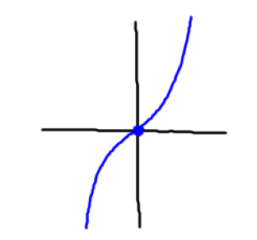
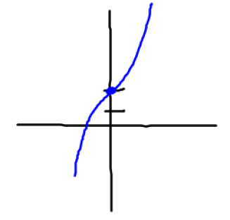
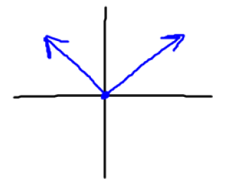
Even/Odd/Neither Assignment – Results on Patty Paper
Patty Paper is used to trace the graphs!
Students are asked to trace the x & y axes from a worksheet.
Then, they trace the functions as verbally instructed.

Slide 35
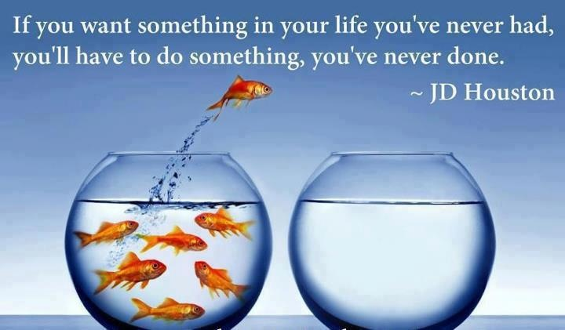
Encouraging the Students
www.pinterest.com

Slide 36

Encouraging the Students
Students need some motivation:
“This is for a grade” (both participation and correctness)
Bonus Points
Peer Pressure

Slide 37

Calculator Instructions after FISH
When a calculator instruction packet is distributed to the students:
Before FISH, the students where lost and frustrated with the packet.
After FISH, all I have to do is point.
Thegraphicsfairy.com

Slide 38
What’s Next
A) Scavenger Hunt in Padlet where students visit:
Library
Career Center
Student Life
Academic Studio
B) More Real World Assignments

Slide 39

Why it works!
Picsndquotes.com

Slide 40

Albert Einstein
onlygags.com

Slide 41
Any Questions?
Questions?
Thoughts?
Suggestions?

Slide 42



