Slide 1
FISH – Following Instructions, A Successful Habit
Jenny Shotwell
Ellen Falkenstein

Slide 2
Learning Catalytics Demo
www.learningcatalytics.com/demo
Enter First Name, Last Name, email address, agree to Privacy Policy, Start
Enter a class session ID to join a session (Enter XXXXXXX and Join)
Click on Show Seat Map, click on your seat, OK
Begin answering the 5 questions

Slide 3
Learning Catalytics

Slide 4
Learning Catalytics
Scores can go into Gradebook with a set percent for correctness and for participation
The room map allows instructor to see who answers (correctly or incorrectly) – plus “I don’t understand” button
Software can put students into groups to discuss the problem
Instructor can grab problems from a library or create his own

Slide 5
Learning Catalytics
Pacing for the problems:
Instructor-Led Synchronous (in class)
Automated Synchronous (outside of class)
Self-Paced (answer in any order)
Self-Test (receive feedback)
Team-Based Assessment

Slide 6
Learning Catalytics
The students enjoy:
The anonymous competitiveness
The teasing from me when I don’t see the answers I need
The group discussion
The break from a normal lecture
Plan to use for mini-quizzes next semester.

Slide 7

Moving on…
The Learning Catalytics Software is just one example of tools we use for the FISH (Following Instructions, A Successful Habit) program.
Laughing-lion-design.com

Slide 8

Why We Use the Term FISH
Lifehacker.com
The author Matthew Kelly was the first to write this quote and attribute the quote to Einstein.
There is no evidence that Einstein actually said this; however, the quotation was based on ideas
circulated among educators for decades.

Slide 9
Why We Started FISH
For the last two chapters in the Paired Intermediate/College Algebra, a calculator instruction packet is distributed to the students.
We were shocked that college students could not read simple step-by-step instructions.
“How do I …” was all we heard even after explaining the packet and practicing.

Slide 10
Why We Started FISH
Too much “hand holding” for word problems
Same questions for calculator asked over and over
Not reading instructions or fine-print
Not even trying to start a problem or assignment

Slide 11
Why We Need FISH
To be successful in college credit courses and beyond, students must:
Learn to follow instructions even if they seem arbitrary
Learn to just get started even if unsure or uncomfortable
Learn to use their “working” memory to complete assignments

Slide 12

Why We Know We Need FISH
Students will argue
about why they should do
seemingly meaningless
assignments.
I tell them to write a short paper to justify their point because my assignment is not meaningless – it is researched and carefully created!!

Slide 13
Padlet Assignment
Students are asked to:
Use google to search for a picture or take a picture of a function
Click on a link that is provided
Load the picture using simple instructions
Email the instructor once complete

Slide 14
Padlet Assignment
The assignment was emailed to the students and given
on paper. The assignment was on blue paper so the team
knows to not help the students – the point is for them to
figure it out!!

Slide 15
Padlet Assignment
Great resource for reading/writing to create group projects.

Slide 16
Padlet Assignment – Group Page

Slide 17
Padlet Assignment - Examples
Absolute Value
Function

Slide 18
Padlet Assignment - Examples

Slide 19
Padlet Assignment - Stats
Out of 62 students:
27 (44%) loaded a picture and emailed the instructor as asked
10 (16%) loaded a picture but did not email
25 (40%) choose to not participate despite offer of bonus test points

Slide 20
Padlet Assignment – Ugh Moments
“Please, please help me – I can’t figure out how to use Padlet” (She had not even tried the software yet.)
“Can I just email the picture to you?”
“Really, I don’t get points because it was late…”
“A cartoon about functions doesn’t work – why not?”

Slide 21
Eagle Mail Assignment

Slide 22
Eagle Mail Assignment

Slide 23

Eagle Mail Assignment
“I can’t get the link to work.”
“My password doesn’t work.”
“I already setup Eagle Mail and sent to my gmail; but, I did not get your email.”
“Why do we have to use Eagle Mail?”

Slide 24

Learning Survey Assignment
The instructor emails the students with links for four learning surveys:
Myer-Briggs
Left/Right Brain
VARK (Visual/Aural/R&W/Kinesthetic)
Color Personality
Whatismylearningstyle.com

Slide 25
Learning Survey Assignment
In addition, the email includes:
Instructions if the link does not work
Specific instructions for the format to be emailed back to the instructor
Due Date

Slide 26
Learning Survey Assignment

Slide 27
Learning Survey Assignment
Out of 64 students:
37 (58%) completed the surveys and responded with correct format
25 (39%) completed the surveys, however, responded with wrong format
2 (3%) did not participate

Slide 28
Learning Survey Assignment
Initially, some students acknowledged email without the surveys
“Can I just print the results and bring them to you?”
“We have to send it to you? – I thought I just had to do the surveys.”
Monday after due date, I submitted 0’s in gradebook – got students attention.

Slide 29
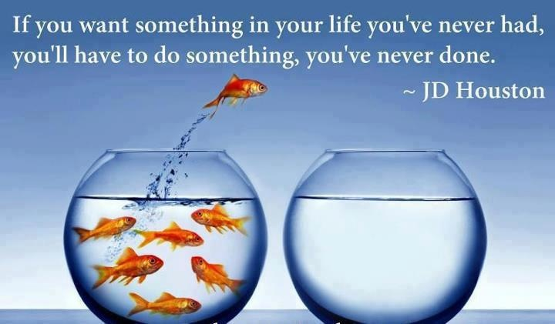
Encouraging the Students
www.pinterest.com

Slide 30

Encouraging the Students
Students need some motivation:
“This is for a grade” (both participation and correctness)
Bonus Points
Peer Pressure

Slide 31

“Pointing to the Instructions”
How many times do I have to point and ask them to “read” the instructions??? Slows down after a few assignments.
Assignments are in blue – to let the entire team remember to not help

Slide 32
Graphing Assignments

Slide 33
Even/Odd/Neither Assignment
Students are given
Common Function page with graphs
3 sheets of patty paper
Verbal Instructions to draw 3 graphs
Once the graphs are drawn, the students are verbally instructed on folding the axes. (Kinesthetic)

Slide 34
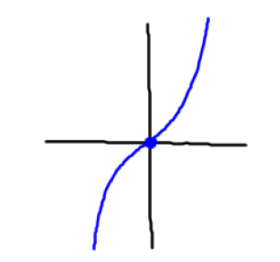
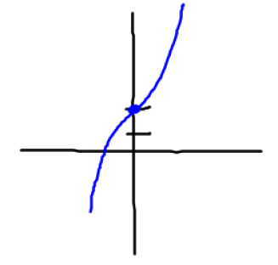
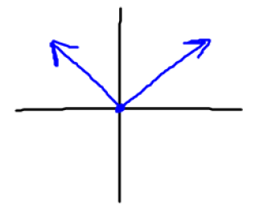
Even/Odd/Neither Assignment
Students are asked to trace the x & y axes from a worksheet.
Then, they trace the functions as verbally instructed.

Slide 35
Even/Odd/Neither Assignment

Slide 36
Logarithm Assignment

Slide 37

Calculator Instructions after FISH
When a calculator instruction packet is distributed to the students:
Before FISH, the students where lost and frustrated with the packet.
After FISH, all I have to do is point.
Thegraphicsfairy.com

Slide 38
What’s Next
A) Scavenger Hunt where students visit:
Library
Career Center
Student Life
Academic Studio
B) More Real World Assignments

Slide 39

Why it works!
Picsndquotes.com

Slide 40
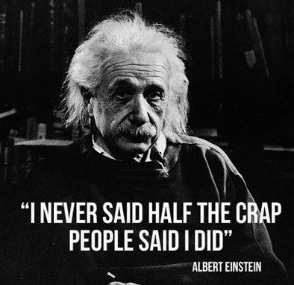
Albert Einstein
onlygags.com

Slide 41
Any Questions?
Questions?
Thoughts?
Suggestions?

Slide 42



