Slide 1
Non-Conventional Success Triggers + NCBOs = College Ready Students
Jenny Shotwell
Ellen Falkenstein

Slide 2
NCBO Program
Two courses
  DSMA 0399
  DSMA 0393 / MATH 1414
http://www.ctcd.edu/ncbo

Slide 3
DSMA 0399 -- NCBO Developmental Mathematics
Students can complete up to three levels of Developmental Mathematics -- Pre-Algebra, Beginning Algebra, and Intermediate Algebra.
Students are provided with the opportunity to master the concepts needed to proceed to the next developmental/college course by working at their own pace in their own learning style.

Slide 4
DSMA 0399 –
Physical Set Up of Class
Students work in computer lab Monday thru Thursday for 1 hour and 20 minutes per day.
Class times are set; however, some flexibility is allowed. Two instructors are available during class time. Other times the lab is staffed by TA and tutor.
Mandatory workshops are held once a month on Fridays -- topics include Learning Styles/Personality Workshop by CTC Mental Health Department, Presentation by CTC Business Team ENACTUS, etc.

Slide 5
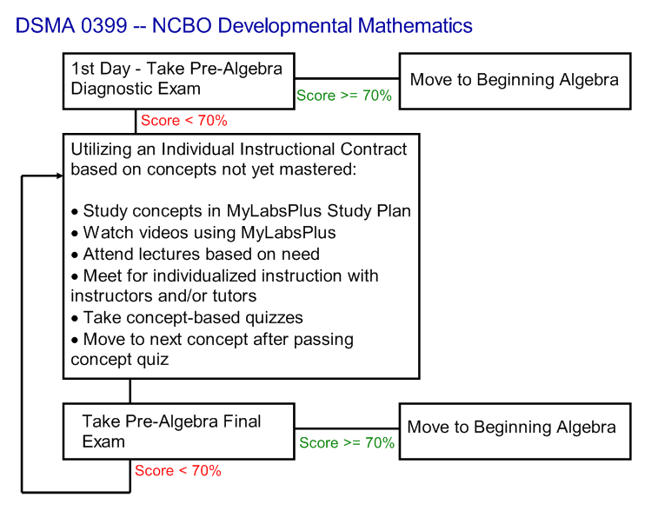
Flowchart for DSMA 0399

Slide 6
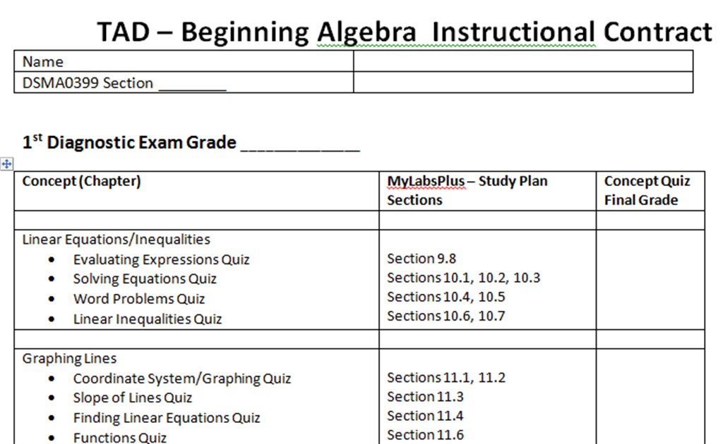
Instruction Contract Samples

Slide 7
DSMA 0393/MATH1414 -- NCBO Intermediate Algebra/College Algebra
Students can complete College Algebra with Intermediate Algebra taught in a Just-In-Time format.
The curriculum, rigor, quizzes/tests coincide with the CTC Math Department's requirements.

Slide 8
DSMA 0393/MATH1414
Physical Setup of Classroom
Students attend class four days a week for 1 hour and 20 minutes per day.
Students are also required to spend two hours a week in the computer lab with a TA and tutor(s).
Instructors team teach; therefore, one instructor is always available during class time to help individual students.

Slide 9
DSMA 0393/MATH1414
Physical Setup of Classroom
Lectures are recorded on Mimio equipment; and, pdf files are posted on MyLabsPlus for review by all students. We can see who accessed the files and number of downloads.
Mandatory workshops are also required for this course.

Slide 10

Why Does It Work?
www.hsa.ie

Slide 11
Why Does It Work?
Application/Interview Process. – Students aware of expectations and course work load.
Sign an Instructional Contract if allowed to enroll. - Proof understand commitment.
With the NCBO program, the student can get individualized help if needed. – The program stresses that the students must find the way that "works for their brain."

Slide 12
Put Responsibility on Student
Based on individual learning styles, students determine which available resources will allow them to be successful. – Mandatory workshop with licensed social worker over survey results.
Faculty member serves as a mentor and ‘cheerleader’ pushing the student to succeed. - This philosophy handles the disconnect often found between faculty/student expectations.

Slide 13
Team Approach
During class time, two instructors are available to students.
The lab has a full-time TA with instructor credentials and a part-time tutor. – Expanding to 2 tutors.
The team works well together and shares the common goal of pursuing student confidence, responsibility, and success.

Slide 14
Team Approach
The students benefit from different explanations/techniques to solve the same problem. - The current team has four Mathematicians, an Engineer, and a Scientist for instructors.
The team uses compassion, tough love, laughter, and sarcasm to allow students to feel at ease in the class/lab. – This strategy leads to increase of student enthusiasm and confidence.

Slide 15
Community Environment
The lab houses students from Pre-Algebra to College Algebra -- students are at all different levels within each class. - Students continue to attend to get assistance in other classes… even some that are not mathematics.
The team does not allow judging, condescending remarks/sounds, or negativity amongst peers.
The personality of the team sets a standard and leads by example right from the start. "We love Math" is the mantra. - This program begins to break down the walls of intimidation around faculty.

Slide 16
Community Environment
(Cohen and Brawer, 1987)
"A community college student is an at risk student facing insurmountable barriers to academic success. Potential impediments to degree completion may include being a first-generation college student, having poor academic skills, being burdened by family and work pressures, and lacking a consistent connection to the college."

Slide 17
Integration of Lab Research
The National Study of Developmental Education found that programs integrating classrooms and labs had significantly higher pass rates in developmental education (Boylan, Bonham, Claxton, and Bliss, 1992). Integration does not constitute providing labs to classroom students; but, rather concerns a target effort to link the classroom to the lab and vice versa. These efforts include directly related activities, instructors dedicating time to the lab, required time in the lab for students, close proximity of the lab and classroom. (Boylan, 2002). The TAD program includes all of these attributes while concentrating on target, accelerated mastery of developmental concepts.

Slide 18
Engages/Enhances Interest in Math with Relevance

Slide 19
DSMA 0399 Data
Data Time frame: Spr13 – Sum14
 | DSMA 0399
Number of students | 252
Complete 0 levels | 29 (incl. drop/withdraws)
Complete 1 level | 72
Complete 2 levels | 128
Complete all 3 levels | 23
59.9% complete multiple levels.

Slide 20
College Algebra Pass Rates
 | 0399 to 1414 | 0393 to 1414
Number of students | 102 | 266
Pass Rate | 93.14% | 94.74%
Withdraw/Drop Rate | 3.92% | 2.26%
** 89 DSMA 0399 students also completed DSMA 0393/MATH 1414.

Slide 21
Traditional Course Pass Rate
 | DSMA 0300 | DSMA 0301 | DSMA 0303
Pass Rate | 41% | 48% | 36.5%
Withdraw/Drop Rate | 31 % | 24.5 % | 39%
** Data collected from Fall 2013 – Spring 2014
Only 5 students completed DSMA 0300 through MATH 1414 in the Spring 2013 to Summer 2014 time frame. Four of those students were successful. - We are researching why we lose students in the sequence and how students jump around in the sequence. This is out of 495 students that took 0300 in Spring/Summer 2014.

Slide 22
Test Scores Vs. Levels Completed
Placement Based On TSI Tests | Total | Developmental Levels Completed |  |  |  |  | Completed College Algebra
 |  | 1 | 2 | 3 | 0 | Drop | Passed | <C or Drop | Enrolled
Pre-Algebra | 212 | 59 | 109 | 19 | 2 | 24 | 94 | 4 | 16
Beginning Algebra | 26 | 7 | 13 | 3 | 0 | 3 | 7 | 2 | 2
Intermediate Algebra | 2 | - | 1 | 1 | - | - | 1 | - | -
College Algebra | 1 | - | 1 | - | - | - | - | - | -
TSI Exempt | 11 | 6 | 4 | - | - | 1 | 3 | - | 1
Test scores do not show student potential, if given opportunities to thrive.

Slide 23
Prior Pre-Algebra Vs. Levels Completed
Prior Dev Math in the Classroom | Total | Developmental Levels Completed |  |  |  |  | Completed College Algebra
 |  | 1 | 2 | 3 | 0 | Drop | Passed | <C or Drop | Enrolled
Pre-Algebra - 1 Semester* | 105 | 28 | 55 | 12 | 1 | 9 | 46 | 1 | 8
Pre-Algebra - 2 Semesters | 14 | 6 | 4 | 4 |  |  | 4 |  | 1
Pre-Algebra - 3 Semesters | 4 | 1 | 3 |  |  |  | 3
* 67 (64%) passed Pre-Algebra in the traditional course prior to NCBO.
Data shows lack of retention from previous traditional courses. (Aaron)

Slide 24
Personality Surveys
Students were required to completed short surveys about their communication skills/learning style / personality.
Temperament Survey
www.humanmetrics.com/cgi-win/jtypes2.asp
Left or Right Brained
www.web-us.com/BRAIN/braindominance.htm
VARK
www.vark-learn.com/english/page.asp?p=questionnaire
Color Communicator
http://freecommunicationquiz.com/free-communication-quiz/

Slide 25
Survey Completions Vs. Levels Completed
Surveys | Total | Developmental Levels Completed |  |  |  |  | Completed College Algebra
 |  | 1 | 2 | 3 | 0 | Drop | Passed | <C or Drop | Enrolled
Completed Surveys | 189 | 28% | 58% | 9% | 1% | 4% | 48% | 2% | 9%
No Surveys | 63 | 30% | 30% | 10% | 0% | 30% | 14% | 3% | 3%
Shows that if they do the work asked, they will be successful, even if the assignment was just the simple task of completing surveys….

Slide 26
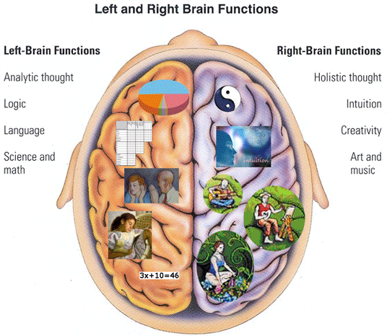
Left Brain or Right Brain ?

Slide 27
Left/Right Brained Vs. Levels Completed
Left Brain Versus Right Brain | Total | Developmental Levels Completed |  |  |  |  | Completed College Algebra
 |  | 1 | 2 | 3 | 0 | Drop | Passed | <C or Drop | Enrolled
Left Brain | 141 | 26% | 58% | 11% | 1% | 4% | 56% | 1% | 10%
Right Brain | 48 | 33% | 56% | 2% | 2% | 6% | 25% | 4% | 6%
Further research on where the Right Brains are going??
Only 5 students went to other mathematics courses… were they right brainers?
Five of the six team members are left brained.

Slide 28
Blue and Gold Communicators
BLUE COMMUNICATION
A Blue's world revolves around people, relationships, and fostering growth in themselves and others. When speaking, they first focus their attention on establishing a relationship or reconnecting with the person. The information they wish to convey is woven into this relationship-building endeavor.
Friendly, Helpful, Empathetic
Optimistic
Expressive with Emotion
Fostering or Maintaining Harmony
May use metaphors to embellish points
TIPS FOR COMMUNICATING WITH BLUES
Acknowledge Them
Show Appreciation
Include them
Have patience
Don't "bark" orders
GOLD COMMUNICATION
Gold’s are generally respectful and responsible. They listen for details so they know what their part is. They usually size up a situation for what would be most appropriate before responding.
Purposeful, Plans Ahead
Respectful, Appropriate
Supportive of Policies and Rules
Detail Oriented, Chronological
Loyal, Devoted
TIPS FOR COMMUNICATING WITH GOLDS
Be Prepared, Give Details
Stay on Target, be Consistent
Show Respect
Don't Interrupt
Recognize Their Contributions

Slide 29
Green and Orange Communicators
GREEN COMMUNICATION
Greens for the most part, communicate for the purpose of gaining or sharing information. During a conversation, their attention is usually focused on the matter at hand, not on the relationship.
Logical and Objective
Includes Facts and Information
Big Picture, Conceptual
Questioning, Critiquing
Wry Sense of Humor
TIPS FOR COMMUNICATING WITH GREENS
Allow Them Time to Ponder
Skip the "small talk"
Avoid Redundancy
Give Big Picture or Point first, then fill in details if asked
Don't misinterpret their need for info as interrogation
ORANGE COMMUNICATION
Generally, Oranges want to share their opinion the minute it hits their mind. Interested in taking action and being expedient, they may skip the softeners and go straight for the "punch-line".
Casual, Playful
Spontaneous, Now Oriented
Fast-Paced, Changes Subjects Quickly
Straightforward
Active, Involved, Mobile
TIPS FOR COMMUNICATING WITH ORANGES
Use "Sound Bites"
Move with Them While They Multitask
Appreciate Their Flair
Allow Options and Flexibility
Lighten Up

Slide 30
Color Communication Vs. Levels Completed
Color Communication Survey | Total | Developmental Levels Completed |  |  |  |  | Completed College Algebra
 |  | 1 | 2 | 3 | 0 | Drop | Passed | <C or Drop | Enrolled
Blue | 109 | 25% | 60% | 9% | 2% | 5% | 53% | 2% | 10%
Gold | 22 | 41% | 45% | 14% | 0% | 0% | 55% | 5% | 0%
Green | 21 | 24% | 62% | 10% | 0% | 5% | 38% | 0% | 14%
Orange | 37 | 32% | 57% | 5% | 0% | 5% | 43% | 3% | 8%
Team: 3 Greens, 2 Blues, and 1 Gold.
Program provides opportunity for success for each communication style.

Slide 31
VARK Study Strategies
Aural Learner
Read your notes aloud.
Explain your notes to another auditory learner.
Ask others to “hear” you restate the material.
Record your notes.
Realize that your notes may be incomplete, you may become so involved in listening that you forget to take complete notes. Talk with other students to help fill out your notes.
Visual Learner
Convert your lecture notes to a visual format.
Study the placement of items, colors, and shapes in your text book.
Put complex concepts into flow charts or graphs.
Use mind or concept mapping in your note taking.
Redraw ideas you create from memory.

Slide 32
VARK Study Strategies
Read/Write Learner
Write your lecture notes out by hand, then type them up when you get home.
Use a structured note taking system like Cornell.
Put ideas and principles in different words.
Translate graphs, and diagrams and charts into text.
Read your notes (silently) again and again.
Kinesthetic Learner
Talk over your notes with another “K” person.
Use photos and pictures to make ideas come to life.
Go back to the lab, your manual, or your notes that include real examples.
Remember that your lecture notes will have real gaps if topics weren’t concrete or relevant to you.
Use case studies to help you learn abstract principles.

Slide 33
VARK Results Vs. Levels Completed
VARK Survey | Total | Developmental Levels Completed |  |  |  |  | Completed College Algebra
 |  | 1 | 2 | 3 | 0 | Drop | Passed | <C or Drop | Enrolled
Visual Learners | 9 | 22% | 44% | 33% | 0% | 0% | 56% | 0% | 0%
Aural Learners | 37 | 30% | 59% | 3% | 0% | 8% | 38% | 0% | 19%
Read/Write Learners | 54 | 26% | 63% | 9% | 2% | 0% | 59% | 2% | 6%
Kinesthetic Learners | 57 | 35% | 56% | 5% | 0% | 4% | 47% | 5% | 5%
Multi-Modal Learners | 32 | 19% | 53% | 16% | 3% | 9% | 50% | 0% | 13%
We thought there will be a clearly difference.

Slide 34
Where we get our energy from?
Extroverts (E)
Vocal
Like variety and action
Often good at greeting people
Like to have people around
Often don’t mind the interruption of answering the telephone
Have a hard time respecting boundaries
Introverts (I)
Have a few friends
Think, do, think
Subtle and reserved, often seen as shy
Hate interruptions
Like quiet for concentration
Have trouble remembering names and faces
Work alone contentedly
territorial
Our team has 2 extroverts and 4 introverts.

Slide 35
How we gather information
Sensors (S)
Don’t trust an answer that suddenly appears
Communicate in a linear fashion
Don’t skim when reading
Don’t like it when people skim in conversations
Sound, accurate, and enjoy repetition
Intuitives (N)
Interested more in what could happen than in what is happening
Communicate like a Christmas tree
Trust their intuition
Often bored with conversations when there are too many facts
Word smiths
Our team has 1 sensor and 5 intuitives.

Slide 36
How we make decisions
Thinkers (T)
Decision based on logic
Keep calm in a crisis
Impersonal
Brief and business like
Are often uncomfortable dealing with other peoples feelings
Tend to be firm minded
May hurt people’s feelings without knowing it
Feelers (F)
Value sentiment
Tend to be very aware of other people and their feelings
Enjoy pleasing people
Like harmony
Dislike telling people unpleasant things
Often let decision be influenced by their own or other people’s personal likes and wishes
Our team has 3 thinkers and 3 feelers.

Slide 37
How we engage the world
Judgers (J)
Need closure
They have rules for themselves and others
Consistent
Orderly
Make plans
Hate being late
Opinions on things that matter to them
Perceivers (P)
Like to keep possibilities open
Will come to closure if forced –maybe
Spontaneous
Open-minded
Tolerant
Curious
Takes pleasure in starting something new, until the newness wears off
Our team has 6 judgers.

Slide 38
Temperament Vs. Levels Completed
Temperament Styles | Total | Developmental Levels Completed |  |  |  |  | Completed College Algebra
 |  | 1 | 2 | 3 | 0 | Drop | Passed | <C or Drop | Enrolled
Introverts | 117 | 26% | 60% | 10% | 1% | 3% | 50% | 2% | 8%
Extroverts | 72 | 31% | 54% | 7% | 1% | 7% | 49% | 3% | 11%
Intuitives | 80 | 29% | 60% | 4% | 3% | 5% | 43% | 1% | 11%
Sensors | 109 | 28% | 56% | 13% | 0% | 4% | 55% | 3% | 7%
Thinkers | 89 | 35% | 49% | 10% | 2% | 3% | 47% | 3% | 7%
Feelers | 100 | 22% | 65% | 8% | 0% | 5% | 52% | 1% | 11%
Judgers | 169 | 27% | 58% | 9% | 1% | 4% | 51% | 2% | 8%
Perceivers | 20 | 35% | 55% | 5% | 0% | 5% | 35% | 5% | 15%
Community Learners are more likely to succeed.

Slide 39
Most Common Temperament Results
ISTJ The Duty Fulfillers - 38
Strengths
Honor their commitments
Take their relationship roles very seriously
Good listeners
Extremely good (albeit conservative) with money
Able to take constructive criticism well
Able to tolerate conflict situations without emotional upheaval
Able to dole out punishment or criticism when called for
Weaknesses
Tend to believe that they are always right
Get involved in “win-lose” conversations
Not naturally in-tune with what others feel
Their value for structure may seem rigid to others
Not likely to give enough praise

Slide 40
Most Common Temperament Results
ISFJ The Nurtures - 27
Strengths
Warm, friendly and affirming by nature
Service-oriented, wanting to please others
Good listeners
Puts forth a lot of effort to fulfill their duties
Take their commitments seriously
Good at taking care of practical matters
Weaknesses
Don’t pay enough attention to their own needs
May have difficulty branching out into new territory
Extreme dislike of conflict and criticism
Unlikely to express their needs, which may cause pent-up frustrations
Have difficulty leaving a bad situation and moving on

Slide 41
Most Common Temperament Results
INTJ The Scientists - 24
Strengths
Not threatened by conflict or criticism
Usually self-confident
Generally extremely intelligent and capable
Take relationships and commitments seriously
Good listeners
Weaknesses
Not naturally in tune with others feelings:
May tend to respond to conflict with logic and reason, rather than the desired emotional support
Not naturally good at expressing feelings and emotions
Tendency to believe that they are always right
Tendency to be unwilling or unable to accept blame

Slide 42
What did we learn?
Give personality surveys early to be able to advise resources to student.
Further research of those students that were not successful.
Further research on traditional student population (incl. online)
Further research on increasing success for Auditory/Kinesthetic in the DSMA 0399 course.

Slide 43
Student Comments
"These classes are neither too demanding, not too easy; they require you to challenge yourself to learn...After about ten years out of college, it was difficult to take a math test or even look at numbers. Now that I've been in this class and with the help of the professors I believe that I have all the tools I need to be successful in the next class."
- feedback from student

Slide 44
Student Comments
"I have always wanted to understand math, but until the DSMA 0399 class I had always felt that it was impossible.“
- quote from student

Slide 45
Student Comments:
The instructors "are both very different teachers from each other; their teaching styles are complementary as are their personalities... They are funny and extremely helpful, I feel so smart and I know I did not have a clue before they taught me so the only difference is having them there teaching. They take time showing me all kinds of ways to do one problem until I get to a way I can do it on my own and fell confident... It is a rare thing to have teachers who devote so much time and care to make sure you are where you want to be in class. "

Slide 46
Student Comments:
"To the two amazing professors. I want to say thank you to both of you. I was scared of this class and you both have made math fun for me. My last teacher yelled at me on the second day and my brain shut down. Now that I'm in this class I feel excited to come to class. I just wanted to let you both know how amazing you are."

Slide 47
Student Comments:
"I feel like I learn more quickly if I'm not put under so much pressure. When I was taking 301 I felt pressured in that class and felt like I was not learning well and what I did learn I was not able to remember for the test. While in the NCBO 0399 course I felt A LOT less pressured and relaxed, so the pressure that I had before was no longer there. I am more than willing to give more of my time for this class as well as effort. I really feel like this is no longer a course I want to be in, but one that I need to be in."
-- A student applying to be in Paired Class.

Slide 48
Student Comments:
"I greatly benefit from having a "noisy" lab where I can ask questions and have one on one help if needed. Math is a tough subject for me..." With the help of the instructors, "I was able to comprehend what I was learning, not only in class but in the lab. They all gave me the tools I need to be successful and spent the extra time with me to break things down to where I could understand Math.

Slide 49
Student Comments:
"This course is self-paced, to an extent, and I like the freedom to work faster or slower in order to really understand the concepts presented."

Slide 50



