Slide 1
Non-Conventional Success Triggers + NCBOs = College Ready Students
Jenny Shotwell
Ellen Falkenstein

Slide 2
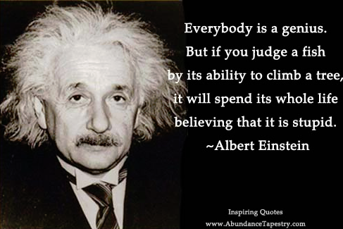
The Quote that Inspired Us
The author Matthew Kelly was the first to write this quote and attribute the quote to Einstein.
There is no evidence that Einstein actually said this; however, the quotation was based on ideas
circulated among educators for decades.

Slide 3
NCBO Program
Four Options
  DSMA 0399
  DSMA 0393 / MATH 1414
  TAD BIT
  DSMA 0391 (Initial Stages)
http://www.ctcd.edu/ncbo

Slide 4
TAD BIT
Two week extension course offered at the end of the term to students that failed the course with a grade in the 60s. Consideration is given to those that have overall average in the 50s if passing prior to final examination.
21 / 30 students were successful.
4 students were allowed into 393/1414 using holistic counseling.
  3 were successful
  1 is currently enrolled.

Slide 5
DSMA 0391
In the early stages of course creation.
Course that merges the curriculum of Pre- and Beginning Algebra.
Taught Mon – Fri for 70 minutes with 12 hour lab requirement.
Planned for pilot in Fall 2015

Slide 6
DSMA 0399 -- NCBO Developmental Mathematics
Students can complete up to three levels of Developmental Mathematics -- Pre-Algebra, Beginning Algebra, and Intermediate Algebra.
Students are provided with the opportunity to master the concepts needed to proceed to the next developmental/college course by working at their own pace in their own learning style.

Slide 7
DSMA 0399 –
Physical Set Up of Class
Students work in computer lab Monday thru Thursday for 1 hour and 20 minutes per day.
Class times are set; however, some flexibility is allowed. Two instructors are available during class time. Other times the lab is staffed by TA and tutor.
Mandatory workshops are held once a month on Fridays -- topics include Learning Styles/Personality Workshop by CTC Mental Health Department, Presentation by CTC Business Team ENACTUS, etc.

Slide 8
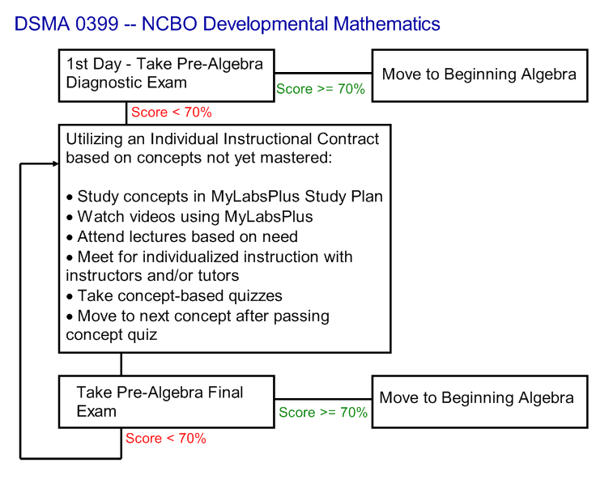
Flowchart for DSMA 0399

Slide 9
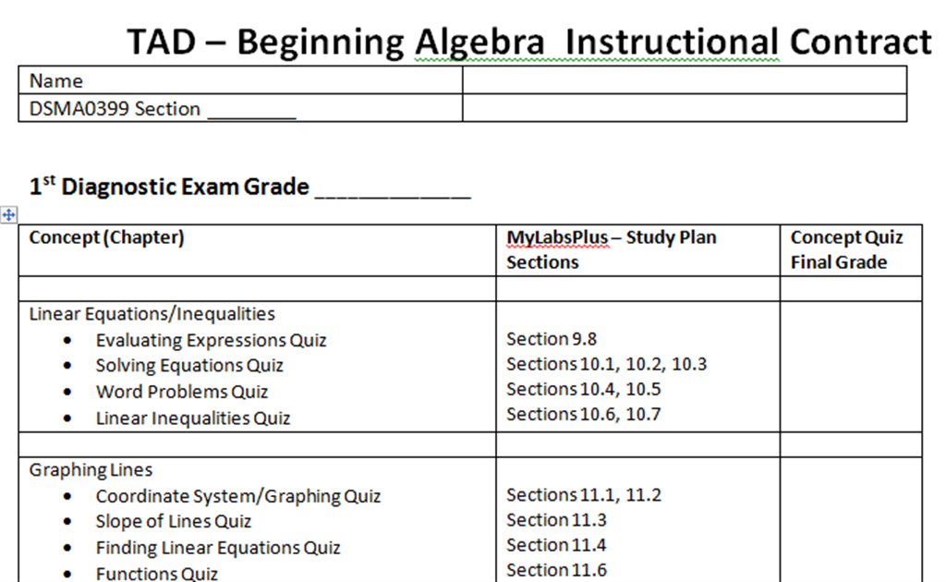
Instruction Contract Samples

Slide 10
DSMA 0393/MATH1414 -- NCBO Intermediate Algebra/College Algebra
Students can complete College Algebra with Intermediate Algebra taught in a Just-In-Time format.
The curriculum, rigor, quizzes/tests coincide with the CTC Math Department's requirements.

Slide 11
DSMA 0393/MATH1414
Physical Setup of Classroom
Students attend class four days a week for 1 hour and 20 minutes per day.
Students are also required to spend two hours a week in the computer lab with a TA and tutor(s).
Instructors team teach; therefore, one instructor is always available during class time to help individual students.

Slide 12
DSMA 0393/MATH1414
Physical Setup of Classroom
Lectures are recorded on Mimio equipment; and, pdf files are posted on MyLabsPlus for review by all students. We can see who accessed the files and number of downloads.
Mandatory workshops are also required for this course.

Slide 13

Why Does It Work?
www.hsa.ie

Slide 14
Why Does It Work?
Application/Interview Process. – Students aware of expectations and course work load.
Sign an Instructional Contract if allowed to enroll. - Proof understand commitment.
With the NCBO program, the student can get individualized help if needed. – The program stresses that the students must find the way that "works for their brain."

Slide 15
Put Responsibility on Student
Based on individual learning styles, students determine which available resources will allow them to be successful. – Mandatory workshop with licensed social worker over survey results.
Faculty member serves as a mentor and ‘cheerleader’ pushing the student to succeed. - This philosophy handles the disconnect often found between faculty/student expectations.

Slide 16
Team Approach
During class time, two instructors are available to students.
The lab has a full-time TA with instructor credentials and two part-time tutor.
The team works well together and shares the common goal of pursuing student confidence, responsibility, and success.

Slide 17
Team Approach
The students benefit from different explanations/techniques to solve the same problem. - The current team has four Mathematicians, an Engineer, and a Scientist for instructors.
The team uses compassion, tough love, laughter, and sarcasm to allow students to feel at ease in the class/lab. – This strategy leads to increase of student enthusiasm and confidence.

Slide 18
Community Environment
The lab houses students from Pre-Algebra to College Algebra -- students are at all different levels within each class. - Students continue to attend to get assistance in other classes… even some that are not mathematics.
The team does not allow judging, condescending remarks/sounds, or negativity amongst peers.
The personality of the team sets a standard and leads by example right from the start. "We love Math" is the mantra. - This program begins to break down the walls of intimidation around faculty.

Slide 19
Community Environment
(Cohen and Brawer, 1987)
"A community college student is an at risk student facing insurmountable barriers to academic success. Potential impediments to degree completion may include being a first-generation college student, having poor academic skills, being burdened by family and work pressures, and lacking a consistent connection to the college."

Slide 20
Integration of Lab Research
The National Study of Developmental Education found that programs integrating classrooms and labs had significantly higher pass rates in developmental education (Boylan, Bonham, Claxton, and Bliss, 1992). Integration does not constitute providing labs to classroom students; but, rather concerns a target effort to link the classroom to the lab and vice versa. These efforts include directly related activities, instructors dedicating time to the lab, required time in the lab for students, close proximity of the lab and classroom. (Boylan, 2002). The TAD program includes all of these attributes while concentrating on target, accelerated mastery of developmental concepts.

Slide 21
Engages/Enhances Interest in Math with Relevance

Slide 22
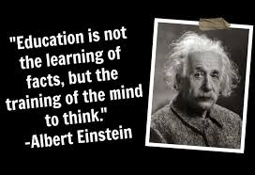
Why it works!
Picsndquotes.com

Slide 23
DSMA 0399 Data
Data Time frame: Spr13 – Fal14
 | DSMA 0399
Number of students | 317 **
Complete 0 levels | 39 (incl. drop/withdraws)
Complete 1 level | 94
Complete 2 levels | 159
Complete all 3 levels | 26
** Data for 1st time in course.
58.4% complete multiple levels.

Slide 24
College Algebra Pass Rates
 | 0399 to 1414 | 0393 to 1414
Number of students | 137 | 330
Pass Rate | 91.2 % | 93.6 %
Withdraw/Drop Rate | 3.6 % | 2.4 %
** 109 DSMA 0399 students also completed DSMA 0393/MATH 1414.

Slide 25
Traditional Course Pass Rate
 | DSMA 0300 | DSMA 0301 | DSMA 0303 | MATH 1414
Number of Students | 1535 | 1172 | 874 | 2070
Pass Rate | 42.4 % | 43.7 % | 44.7 % | 58.3 %
Withdraw/Drop Rate | 31.3 % | 24.1 % | 33.5 % | 21.9 %
39 Students successfully completed all three DSMA levels.
11 students completed DSMA 0300 through MATH 1414.
*** This comes from the 900 students that started DSMA 0300, lowest level in the CY 2013. These students would have 4 terms to complete all 4 courses.

Slide 26
Test Scores Vs. Levels Completed
Placement Based On TSI Tests | Total | Developmental Levels Completed |  |  |  |  | Completed College Algebra
 |  | 1 | 2 | 3 | 0 | Drop | Enrolled | Passed
Pre-Algebra | 263 | 76 | 134 | 20 | 2 | 31 | 117 | 109
Beginning Algebra | 38 | 11 | 19 | 5 | 0 | 3 | 15 | 11
Intermediate Algebra | 2 | - | 1 | 1 | - | - | 1 | 1
College Algebra | 1 | - | 1 | - | - | - | - | -
No Scores | 13 | 7 | 4 | - | - | 2 | 4 | 4
Test scores do not show student potential, if given opportunities to thrive.

Slide 27
Prior Pre-Algebra Vs. Levels Completed
Prior Dev Math in the Classroom | Total | Developmental Levels Completed |  |  |  |  | Completed College Algebra
 |  | 1 | 2 | 3 | 0 | Drop | Enrolled | Passed
Pre-Algebra - 1 Semester | 121 | 32 | 66 | 12 | 1 | 10 | 59 | 57
Pre-Algebra - 2 Semesters | 16 | 8 | 4 | 4 | - | 4 | 5 | 5
Pre-Algebra - 3 Semesters | 5 | 1 | 4 | - | - | 4 | 3 | 2
* 83 passed Pre-Algebra in the traditional course prior to NCBO.
Data shows lack of retention from previous traditional courses. (Aaron)

Slide 28
Personality Surveys
Students were required to completed short surveys about their communication skills/learning style / personality.
Temperament Survey
www.humanmetrics.com/cgi-win/jtypes2.asp
Left or Right Brained
www.web-us.com/BRAIN/braindominance.htm
VARK
www.vark-learn.com/english/page.asp?p=questionnaire
Color Communicator
http://freecommunicationquiz.com/free-communication-quiz/

Slide 29
Survey Completions Vs. Levels Completed
Surveys | Total | Developmental Levels Completed |  |  |  |  | Completed College Algebra
 |  | 1 | 2 | 3 | 0 | Drop | Enrolled | Passed
Completed Surveys | 244 | 29.5 % | 54.5 % | 8.2 % | 0.8 % | 7.0 % | 120 | 93.3 %
No Surveys | 73 | 30.1 % | 35.6 % | 8.2 % | 0% | 26.0 % | 17 | 76.5 %
Shows that if they do the work asked, they will be successful, even if the assignment was just the simple task of completing surveys….

Slide 30
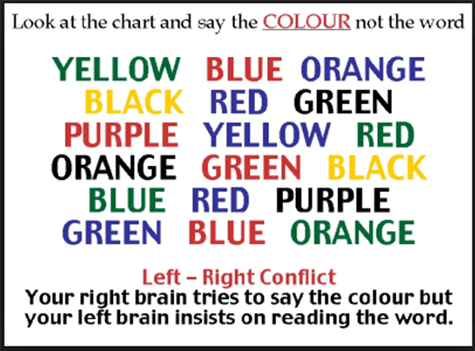
Left Brain or Right Brain ?

Slide 31


Right Brain or Left Brain ?
Processes
information by
starting with the
answer – sees
the big picture
Processes
information by
arranging pieces
in logical order to
draw conclusions
Thinks outside
the box
Thinks according
to rules and
patterns

Slide 32
Left/Right Brained Vs. Levels Completed
Left Brain Versus Right Brain | Total | Developmental Levels Completed |  |  |  |  | Completed College Algebra
 |  | 1 | 2 | 3 | 0 | Drop | Enrolled | Passed
Left Brain | 181 | 29.3 % | 54.1 % | 9.4 % | 5.5 % | 6.6 % | 98 | 95.9 %
Right Brain | 63 | 36.5 % | 50.8 % | 3.2 % | 1.6 % | 7.9 % | 22 | 81.8 %
Right & Left | 4 | 0 % | 50.0 % | 25.0 % | 0 % | 0 % | - | -
Six of the seven team members are left brained.

Slide 33
Color Communicators
BLUE COMMUNICATORS
Collaborative
Team Builder
People Person
Frustrated by: Lack of Communication
GOLD COMMUNICATORS
Efficient
Systematic/Organized
Helpful
Frustrated by: Routine
GREEN COMMUNICATORS
Logical
Self-sufficient
Inquisitive
Frustrated by: Lack of Structure
ORANGE COMMUNICATORS
Problem-Solver
Multi-Tasker
Action-Oriented
Frustrated by: Too Much Structure

Slide 34
Tips for Communicating
TIPS FOR COMMUNICATING WITH BLUES
Acknowledge/Include Them
Have patience
Don't "bark" orders
TIPS FOR COMMUNICATING WITH GOLDS
Be Prepared, Give Details
Show Respect/Don't Interrupt
Recognize Their Contributions
TIPS FOR COMMUNICATING WITH GREENS
Allow Them Time to Ponder
Avoid Redundancy
Give Big Picture or Point first, then fill in details if asked
TIPS FOR COMMUNICATING WITH ORANGES
Use "Sound Bites"
Move with Them While They Multitask
Allow Options and Flexibility

Slide 35
Color Communication Vs. Levels Completed
Color Communication Survey | Total | Developmental Levels Completed |  |  |  |  | Completed College Algebra
 |  | 1 | 2 | 3 | 0 | Drop | Enrolled | Passed
Blue | 139 | 26.6 % | 57.6 % | 7.2 % | 1.4 % | 7.2 % | 73 | 93.2 %
Gold | 28 | 35.7 % | 42.9 % | 17.9 % | 0% | 3.6 % | 14 | 85.7 %
Green | 33 | 33.3 5 | 54.5 % | 18.2 % | 0% | 6.1 % | 13 | 100 %
Orange | 46 | 34.8 % | 50 % | 6.5 % | 0% | 8.7 % | 20 | 95 %
Team: 4 Greens, 2 Blues, and 1 Gold.
Program provides opportunity for success for each communication style.
Looking at Golds – maybe their desire for no interruptions!

Slide 36
Why does the program works for all colors?
BLUE COMMUNICATORS
Lab is a Community
Daily Contact with Teacher/TAs/Tutors
Geared for group work
Detailed Maps
Frustrated by: Lack of Communication
GOLD COMMUNICATORS
Rewarded for Prior Mastery
Options for Learning (HW, Study Plan, Tutors, Etc.)
Detailed Maps
Frustrated by: Routine
GREEN COMMUNICATORS
Detailed Maps
Can work on their own and get help only when needed
Quiz gives objective/HW gives details
Frustrated by: Lack of Structure
ORANGE COMMUNICATORS
Options for Learning (HW, Study Plan, Tutors, Etc.)
Lab allows Music/Headphones, movement
Flexibility in lab times
Frustrated by: Too Much Structure

Slide 37

VARK Learning Styles

Slide 38
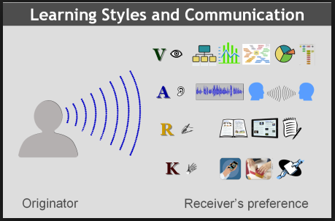
VARK Learning Styles

Slide 39
VARK Study Strategies
Aural Learner
Read your notes aloud.
Record your notes.
Create songs to remember. (Youtube)
Realize that your notes may be incomplete, you may become so involved in listening that you forget to take complete notes. (Multiple resources to include Mimio/Study Plan/videos etc.)
Visual Learner
Convert your lecture notes to a visual format.
Study the placement of items, colors, and shapes in your text book.
Put concepts into flow charts, diagrams, or graphs.
Use mind or concept mapping in your note taking.
Use videos to learn. (MyLabsPlus, KhanAcademy, Youtube)

Slide 40
VARK Study Strategies
Read/Write Learner
Write your lecture notes out by hand, then type them up when you get home. (Mimio)
Use a structured note taking system like Cornell.
Put ideas and principles in different words. (Diverse teachers/TAs/Tutors)
Translate graphs, and diagrams and charts into text.
Read your notes (silently) again and again.
Kinesthetic Learner
Practice doing something to learn it (I do, You do, we do)
Use photos and pictures to make ideas come to life. (Mimio)
Manipulate objects/materials (Patty paper)
Remember that your lecture notes will have real gaps if topics weren’t concrete or relevant to you. (find real examples)

Slide 41
VARK Results Vs. Levels Completed
VARK Survey | Total | Developmental Levels Completed |  |  |  |  | Completed College Algebra
 |  | 1 | 2 | 3 | 0 | Drop | Enrolled | Passed
Visual Learners | 13 | 15.4 % | 53.8 % | 23.1 % | 0% | 7.7 % | 5 | 100 %
Aural Learners | 44 | 27.3 % | 59.1 % | 4.5 % | 0% | 9.1 % | 22 | 90.9 %
Read/Write Learners | 74 | 29.7 % | 58.1 % | 9.5 % | 1.4 % | 1.4 % | 36 | 97.2 %
Kinesthetic Learners | 75 | 37.3 % | 50.7 % | 4.0 % | 0% | 8.0 % | 36 | 88.9 %
Multi-Modal Learners | 39 | 23.1 % | 48.7 % | 10.3 % | 2.6 % | 12.8 % | 21 | 95.2 %
We thought there will be a clearly difference.

Slide 42
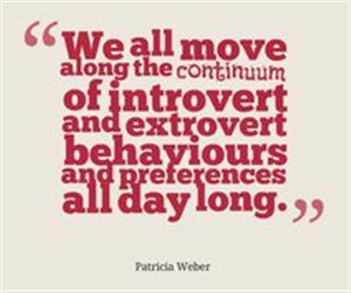
Where we get our energy from?

Slide 43
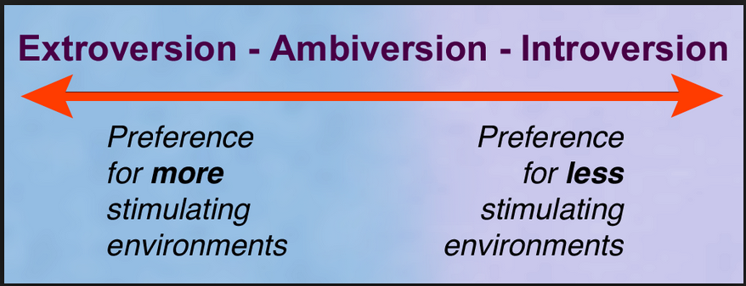
Where we get our energy from?

Slide 44
Where we get our energy from?
Extroverts (E)
Energized by being around people
Encourage their enthusiasm
Allow them to talk things out
Let them dive right in
Offer them options
Introverts (I)
Energized through reflection
Let them observe first
Give them time to think
Respect their introversion
Give them warning of changes
Our program supplies an environment where extroverts and introverts are comfortable.
Our team has 2 extroverts and 5 introverts.
Information from www.myersbriggs.org

Slide 45
How we gather information
Sensors (S)
Process information through the five senses
Focus on the present
Factual
Concrete Thinkers
Intuitives (N)
Process information through patterns & impressions
Focus on the future
Focus on possibilities
Abstract Thinkers
With many choices/resources, our program allows students to learn and communicate according to their needs.
Our team has 1 sensor and 6 intuitives.
Information from www.myersbriggs.org

Slide 46
How we make decisions
Thinkers (T)
Look for logical explanations/solutions
Task-oriented
Feelers (F)
Use communications often
People-oriented
The diverse lab lets the Thinkers hunker down and get to work on the tasks on their map and lets the Feelers work with others to complete the goal.
Our team has 4 thinkers and 3 feelers.
Information from www.myersbriggs.org

Slide 47
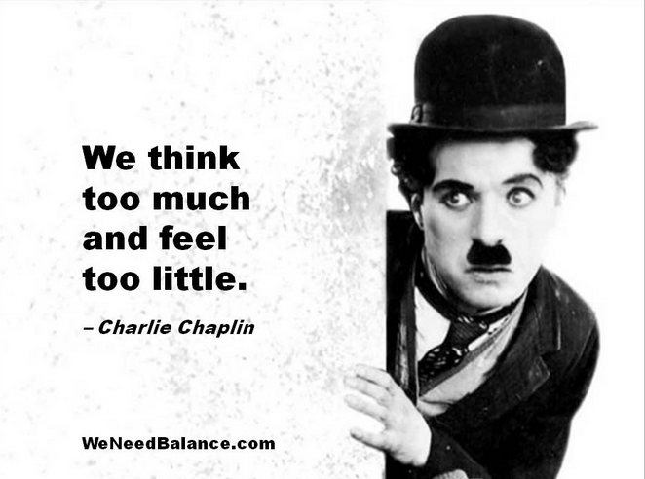
How we make decisions
Thinkers do not
necessarily
“think better”
than feelers –
just think different!

Slide 48
How we engage the world
Judgers (J)
More structured
Make lists
Utilize time management
Focus on the goal (sometimes too much and miss information)
Perceivers (P)
More Flexible
Stimulated by approaching deadline
Open to new information (sometimes too long & miss a deadline)
With the structured self-paced setup of our lab, students can engage their way. For the judgers, the team helps them “see the forest for the trees”. For the few Perceivers, the team helps them keep moving even before the deadline.
Our team has 7 judgers.
Information from www.myersbriggs.org

Slide 49
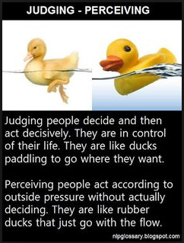
How we engage the world

Slide 50
Temperament Vs. Levels Completed
Temperament Styles | Total | Developmental Levels Completed |  |  |  |  | Completed College Algebra
 |  | 1 | 2 | 3 | 0 | Drop | Enrolled | Passed
Introverts | 139 | 28.1 % | 57.6 % | 10.1 % | 0.7 % | 4.3 % | 73 | 91.8 %
Extroverts | 105 | 32.4 % | 50.5 % | 5.7 % | 1 % | 7.9 % | 47 | 95.7 %
Intuitives | 111 | 27.9 % | 55 % | 5.4 % | 1.8 % | 9.9 % | 47 | 95.7 %
Sensors | 133 | 30.8 % | 54.1 % | 10.5 % | 0% | 4.5 % | 73 | 91.8 %
Thinkers | 111 | 32.4 % | 49.5 % | 9.9 % | 1.8 % | 6.3 % | 53 | 92.5%
Feelers | 133 | 27.1 % | 58.6 % | 6.8 % | 0% | 7.5 % | 67 | 94.0 %
Judgers | 216 | 29.6 % | 55.6 % | 8.8 % | 0.9 % | 5.1 % | 109 | 93.6 %
Perceivers | 28 | 28.6 % | 46.4 % | 3.6 % | 0% | 21.4 % | 11 | 90.9 %
Community Learners are more likely to succeed.

Slide 51
Most Common Temperament Results
ISTJ The Duty Fulfillers - 42
Strengths
Honor their commitments
Take their relationship roles very seriously
Good listeners
Extremely good (albeit conservative) with money
Able to take constructive criticism well
Able to tolerate conflict situations without emotional upheaval
Able to dole out punishment or criticism when called for
Weaknesses
Tend to believe that they are always right
Get involved in “win-lose” conversations
Not naturally in-tune with what others feel
Their value for structure may seem rigid to others
Not likely to give enough praise

Slide 52
Most Common Temperament Results
ISFJ The Nurtures - 35
Strengths
Warm, friendly and affirming by nature
Service-oriented, wanting to please others
Good listeners
Puts forth a lot of effort to fulfill their duties
Take their commitments seriously
Good at taking care of practical matters
Weaknesses
Don’t pay enough attention to their own needs
May have difficulty branching out into new territory
Extreme dislike of conflict and criticism
Unlikely to express their needs, which may cause pent-up frustrations
Have difficulty leaving a bad situation and moving on

Slide 53
Most Common Temperament Results
ENFJ The Givers - 32
Strengths
Good verbal communication skills
Very perceptive about people’s thoughts and motives
Motivational, inspirational; brings out the best in others
Warm and affirming, lively sense of humor, energetic
Strive for “win-win” situations, driven to meet others needs
Weaknesses
Tendency to be smothering and over-protective, controlling and/or manipulative
Don’t pay enough attention to their own needs
Tend to be critical of opinions and attitudes that don’t match their own
Tendency to blame themselves when things go wrong
May be very unbending in certain areas

Slide 54
Most Common Temperament Results
INTJ The Scientists - 31
Strengths
Not threatened by conflict or criticism
Usually self-confident
Generally extremely intelligent and capable
Take relationships and commitments seriously
Good listeners
Weaknesses
Not naturally in tune with others feelings:
May tend to respond to conflict with logic and reason, rather than the desired emotional support
Not naturally good at expressing feelings and emotions
Tendency to believe that they are always right
Tendency to be unwilling or unable to accept blame

Slide 55
What’s next ??
Implementation of pilot for DSMA 0391
Further research of those students that were not successful.
Research on traditional student population (incl. online)
Further research on increasing success for Kinesthetic/Multi-Modal in the DSMA 0399 course.
Pilot the DSMA 0399 in the online format.
Attempt models in the Reading/Writing courses

Slide 56
Student Comments
"These classes are neither too demanding, not too easy; they require you to challenge yourself to learn...After about ten years out of college, it was difficult to take a math test or even look at numbers. Now that I've been in this class and with the help of the professors I believe that I have all the tools I need to be successful in the next class."
- feedback from student

Slide 57
Student Comments
"I have always wanted to understand math, but until the DSMA 0399 class I had always felt that it was impossible.“
- quote from student

Slide 58
Student Comments:
The instructors "are both very different teachers from each other; their teaching styles are complementary as are their personalities... They are funny and extremely helpful, I feel so smart and I know I did not have a clue before they taught me so the only difference is having them there teaching. They take time showing me all kinds of ways to do one problem until I get to a way I can do it on my own and fell confident... It is a rare thing to have teachers who devote so much time and care to make sure you are where you want to be in class. "

Slide 59
Student Comments:
"To the two amazing professors. I want to say thank you to both of you. I was scared of this class and you both have made math fun for me. My last teacher yelled at me on the second day and my brain shut down. Now that I'm in this class I feel excited to come to class. I just wanted to let you both know how amazing you are."

Slide 60
Student Comments:
"I feel like I learn more quickly if I'm not put under so much pressure. When I was taking 301 I felt pressured in that class and felt like I was not learning well and what I did learn I was not able to remember for the test. While in the NCBO 0399 course I felt A LOT less pressured and relaxed, so the pressure that I had before was no longer there. I am more than willing to give more of my time for this class as well as effort. I really feel like this is no longer a course I want to be in, but one that I need to be in."
-- A student applying to be in Paired Class.

Slide 61
Student Comments:
"I greatly benefit from having a "noisy" lab where I can ask questions and have one on one help if needed. Math is a tough subject for me..." With the help of the instructors, "I was able to comprehend what I was learning, not only in class but in the lab. They all gave me the tools I need to be successful and spent the extra time with me to break things down to where I could understand Math.

Slide 62
Student Comments:
"This course is self-paced, to an extent, and I like the freedom to work faster or slower in order to really understand the concepts presented."

Slide 63



