Slide 1
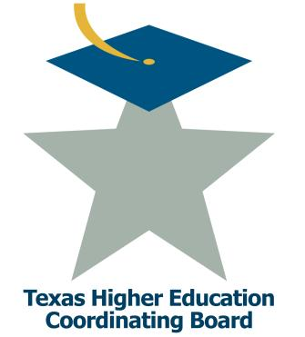
Central Texas College
Pathways to Progress Institute
September 21-23, 2014| The Fairmont Dallas Hotel
Jenny Shotwell & Ellen Falkenstein

Slide 2
Overview of NCBO Program
DSMA 0399
Students given opportunity to complete multiple DSMA courses during 1 academic term based on Mastery Learning. Every student starts at lowest level.
DSMA 0393 / MATH 1414
Co-requisite model of Intermediate Algebra and College Algebra along with specialized resources to the students outside of class.
http://www.ctcd.edu/ncbo
Notes:
Describe key characteristics of initiative, include: subject area addressed, launch date, target student population, placement protocol, required professional development for faculty/staff, etc.

Slide 3
Why Does It Work?
All students are required to submit application and be interviewed.
Team Approach
Tad Lab – “Noisy Lab”
Self Discovery/credit for mastered concepts
Puts Responsibility back on the student.
Community Environment
Promotes Self Confidence/Enthusiasm
Engages/Enhances Interest in Math with Relevance
Faculty new to the program are paired with
existing faculty for on-the-job training.

Slide 4
Data Collection for Spr13 – Sum14
 | DSMA 0399
Number of students | 252
Complete 0 levels | 29 (incl. drop/withdraws)
Complete 1 level | 72
Complete 2 levels | 128
Complete all 3 levels | 23
Notes:
Describe successes to date. Include outcome results if available.

Slide 5
Data Collection for Spr13 – Sum14
 | 0399 to 1414 | 0393 to 1414
Number of students | 102 | 266
Pass Rate | 93.14% | 94.74%
Withdraw/Drop Rate | 3.92% | 2.26%
** 89 DSMA 0399 students also completed DSMA 0393/MATH 1414.

Slide 6
Challenges
Financial Aid, Veterans - Solved
Budget Buy-In At Program Creation - Solved
Documentation of Level Completion in Registrar.
Are they TSI Complete?
Expansion Growth (facilities, staff, money)
Application Verification Process
Notes:
Describe challenges with program implementation (e.g., student recruitment, faculty/staff buy in, sustainability, scalability, etc.)

Slide 7
Lessons Learned
Never show you can move a mountain with just a shovel. -> Next time they will expect you to use your bare hands.
Never meet every affected party on campus at one time. -> Meet in small groups.
For co-req. model, carefully screen transfer credit/credit from other campuses -> Discussing standardizing eligible students.
Similar success with new faculty -> Faculty must be enthusiastic for students to succeed.
Notes:
Describe top 3 lessons learned.

Slide 8
Closing Comments
Scaling – House Bill 5
Overhaul all Dev Studies labs to enhance experience for regular classroom students. – Construction and re-staffing.
Research expansion of Co-Req. model with other credit bearing math courses. – Is there a need for our student population.
Possible pilot of DSMA 0399 in an online/hybrid format.
Further piloting of two week extension initiative- TAD BIT.
Notes:
Describe the institution’s future plan for the initiative (e.g., scaling, increase target student population, etc.)

