Slide 1
Targeted, Accelerated, Community Learning NCBO DevMath Program
Jenny Shotwell
Ellen Falkenstein

Slide 2
CTC History
Celebrating our 50 year anniversary.
~ 44,000 students
  ~ 17,000 on main campus
Average graduate age : 35
Classes offered worldwide
  Including Navy ships
  Military Installations
  Online

Slide 3

The Quote that Inspired Us
The author Matthew Kelly was the first to write this quote and attribute the quote to Einstein.
There is no evidence that Einstein actually said this; however, the quotation was based on ideas
circulated among educators for decades.

Slide 4
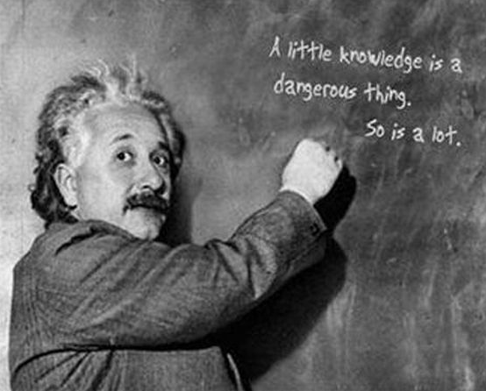
Targeted, Accelerated, Developmental Education (TAD)
In the initial meetings we were told to “get it done” and to be sure that we had a catchy acronym.
TAD seemed perfect:
A tad of knowledge
A tad of money
But, a lot of WORK
quotespictures.com

Slide 5
NCBO Program
Four Options:
TAD (DSMA 0399 covers Pre-,
Beginning, Intermediate Algebra)
2) TAD Plus (DSMA 0393 / MATH 1414
paired Intermediate/College Algebra)
3) TAD Bit (extender initiative)
4) TAD (Name being determined) Accelerated lecture class
combining Pre/Beg Algebra.

Slide 6
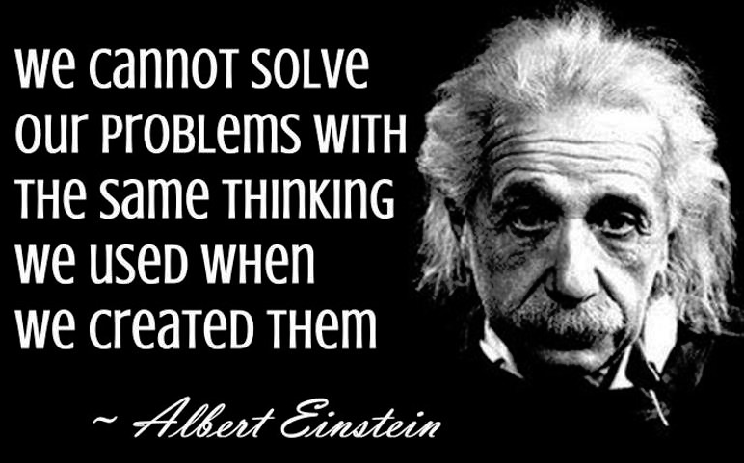
moco-choco.com

Slide 7
Lessons Learned –
Program Development
Meet in small groups
Never mention free in front of Budget.
What happens in classroom - stays in the classroom.
Offering for 3 credit hours, opens the door to VA / financial aid students.
Think outside box for PR.
Offer students something free for pilots.
Never show you can move a mountain with just a shovel.

Slide 8
Basic Definition of TAD
Students are provided with the opportunity to master the concepts needed to proceed to the next developmental/college course by working at their own pace and learning style in a targeted instructional contract.
Students complete up to three levels of Developmental Mathematics -- Pre-, Beginning, and Intermediate Algebra in one semester.

Slide 9
TAD – DSMA 0399
Students complete an application/information session/ sign course contract.
Work off an individualized instructional contract. (one for each level)
Mastery levels must be obtained to move on.
Everyone starts in Pre-Algebra.

Slide 10
Conquering the Map
For each concept, students take an initial quiz that builds a homework based on mastery.
Next, student studies using homework, “Help Me Solve This”, videos, individual help in lab, and mini workshops
Finally, the student retakes the quiz. Once they score a 80% or higher, they may move on to the next concept.

Slide 11
Grading
Students must pass the Final Exam with > 70% to receive credit.
The quiz/homework grades are only used to proceed to the next concept.
Once the student has passed the Pre-Algebra Final Exam, they have passed the course – the next level is a bonus if passed.
Final exam grade is entered as a internal placement test for Registrar.

Slide 12
Physical Set Up of Class
Students are in lab Monday thru Thursday for 1 hour and 20 minutes per day.
Class times are set; however, some flexibility is allowed.
Mandatory Learning Styles/Personality Workshop by CTC Mental Health Department.
Lab currently holds 58 student computers, and 2 student round tables.

Slide 13

Why it works!
Picsndquotes.com

Slide 14
Why it Works
Individualized help
Self Discovery
Credit for previous knowledge
Students can choose resources based on their learning style.
“Noisy”, relaxed environment – even supply candy!
Lab houses students currently form Pre-Algebra through Calculus.

Slide 15
Why It Works
Team Approach
  4 unique faculty members
    Different explanations and techniques.
  Play well with others
  United front with common goal of student success.
  Serve as a ‘cheerleader’ and mentor
  uses compassion, tough love, laughter, and sarcasm to allow students to feel at ease in the class/lab.

Slide 16
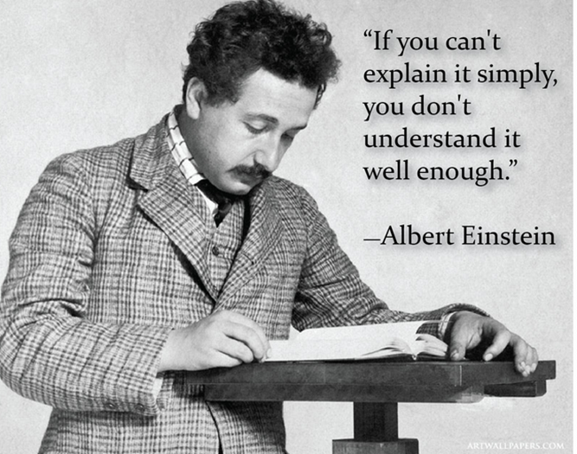

Slide 17


New Team Members
Similar success with new faculty -> Faculty must be enthusiastic for students to succeed. Pair new faculty with existing faculty for on-the-job training.
“Uninspired” faculty
-Need Not Apply.

Slide 18
DSMA 0399 Data
Data Time frame: Spr13 – Sum15
 | DSMA 0399
Number of students | 410 **
Complete 0 levels | 48 (incl. drop/withdraws)
Complete 1 level | 150
Complete 2 levels | 184
Complete all 3 levels | 28
** Data for 1st time in course.
51.7% complete multiple levels.

Slide 19
College Algebra Pass Rates
 | 0399 to 1414
Number of students | 177
Pass Rate | 88.1 %
Withdraw/Drop Rate | 3.95 %

Slide 20
Traditional Course Pass Rate
 | DSMA 0300 | DSMA 0301 | DSMA 0303 | MATH 1414
Number of Students | 1535 | 1172 | 874 | 2070
Pass Rate | 42.4 % | 43.7 % | 44.7 % | 58.3 %
Withdraw/Drop Rate | 31.3 % | 24.1 % | 33.5 % | 21.9 %
39 Students successfully completed all three DSMA levels.
11 students completed DSMA 0300 through MATH 1414.
*** This comes from the 900 students that started DSMA 0300, lowest level in the CY 2013. These students would have 4 terms to complete all 4 courses.

Slide 21
Recent Discoveries
Works for all the learning styles.
Placement test scores showed no affect on levels completed.
Student Population Changes
  Attendance issues
  Increase in first semester students
  Defiant to the “system”
  “Enabled” students

Slide 22
Questions?
Thoughts?
Comments

Slide 23
TAD Plus -- NCBO Intermediate Algebra/College Algebra
Students can complete College Algebra with Intermediate Algebra taught in a Just-In-Time format.
The curriculum, rigor, quizzes/tests coincide with CTC Math Department's requirements.
Instructors team teach; therefore, one instructor is always available during class to help individual students.

Slide 24

TAD Plus – Paired Class
Physical Setup of Classroom
Attend class four days a week (80 min/day)
Mandatory two hours a week in lab with a TA and tutor(s).
Lectures recorded on Mimio Smartboard equipment and are posted on MyLabsPlus
www.mimio.com

Slide 25
Engages/Enhances Interest in Math with Relevance

Slide 26
TAD Plus Data
432 Students have gone through the program.
 | Number Students | Percentages
A | 192 | 44.4 %
B | 115 | 26.6 %
C | 89 | 20.6 %
D/F | 22 | 5.1 %
W/Drop | 14 | 3.2 %
91.7 % Pass Rate

Slide 27
Recent Discoveries
Works for all the learning styles.
Placement test scores may not be a good indicator for success.
Transfer students from other colleges or campuses.
Student Population Changes
  Increase in first semester students
  Defiant to the “system”
  Unable to follow simple instructions

Slide 28
Questions?
Thoughts?
Comments?

Slide 29
TAD BIT
Two week extension course offered at the end of the term to students that failed the course with a grade in the 60s.
Consideration is given to those that have overall average in the 50s if passing prior to final examination.
Meet in lab with instructor/TA/tutor.
Minimum time is 2 hours a day / 4 days a week.

Slide 30
TAD BIT
Faculty member is paid at the adjunct rate.
Use electronic diagnostic/final
Free to the student
Grade Change sent to change student’s grade to a C.

Slide 31
TAD BIT Data
Data collected over 5 terms.
Course: | Pre Algebra | Beginning Algebra | Intermediate Algebra | Total
Successful Students | 16 | 15 | 6 | 37
Total Enrolled | 23 | 26 | 8 | 57
Percent Successful | 69.6 % | 57.7 % | 75 % | 64.9%

Slide 32
DSMA 0391
Piloting one class this term – 21 students
Took a traditional Pre-Algebra class and offered students a BOGO deal.
Students were given textbook and access to My Labs Plus for free.
Allowed to use four function calculator
Class meets 4 days a week for 1 hr and 20 minutes.
Students required to complete 12 hours of monitored lab time.

Slide 33
What’s Next ?
Creation phase of DSMA co-req. with Math 1332.
Next year or two we will have program expansion due to new lab facility.
Offering DSMA 0399 online

Slide 34

Albert Enstein
onlygags.com

Slide 35
www.ctcd.edu/ncbo
Jenny.Shotwell@ctcd.edu
Ellen.Falkenstein@ctcd.edu

Slide 36



