Slide 1
Rewarding Students for Previous Knowledge and Dedication in Developmental Education
Jenny Shotwell
Ellen Falkenstein

Slide 2

State Mandate
The Texas Legislature mandated that colleges offer Non-Course Based Options (NCBOs) starting in Spring 2013.
The intent of the mandate was to allow students options to complete their DevEd courses quickly and successfully.
The definition of an NCBO changed over time to “non-traditional” based options
thewoodlandsdivorce.com

Slide 3

Quick Timeframe
Colleges were given a quick turnaround to offer at least one NCBO.
The State definitions/guidance of an NCBO were ambiguous and vague.
And, so, the work was just starting!!
pointsized.wordpress.com

Slide 4

The Quote that Inspired Us
The author Matthew Kelly was the first to write this quote and attribute the quote to Einstein.
There is no evidence that Einstein actually said this; however, the quotation was based on ideas
circulated among educators for decades.

Slide 5
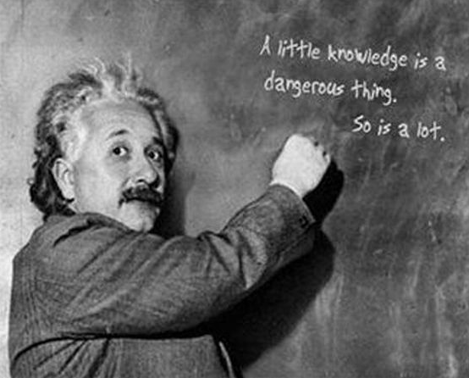
Targeted, Accelerated, Developmental Education (TAD)
In the initial meetings with the Dean of Student Services, she basically told us to “get it done” and to be sure that we had a catchy acronym.
TAD seemed perfect:
A tad of knowledge
A tad of money
But, a lot of WORK
quotespictures.com

Slide 6
NCBO Program
Three Options:
TAD (DSMA 0399 covers Pre-,
Beginning, Intermediate Algebra)
2) TAD Plus (DSMA 0393 / MATH 1414
paired Intermediate/College Algebra)
3) TAD Bit (extender initiative)
http://www.ctcd.edu/ncbo

Slide 7
Issues to be Solved
How do we best assist Financial Aid and Veterans Affairs students’ needs?
How does Registrar denote completion of each level?
How do we get students enrolled?
Where can we find a space for a lab?
How do we pay for computers and furniture?
How do we pay for TAs and tutors?
What should we use for curriculum, software, instructional materials?

Slide 8
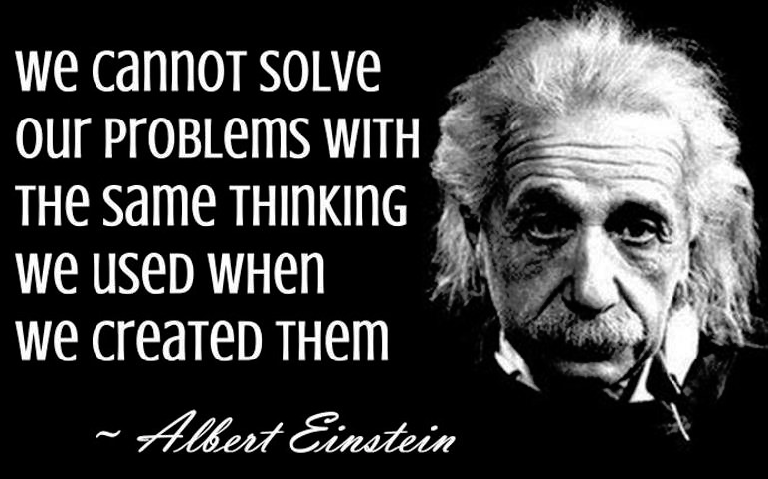
moco-choco.com

Slide 9

First Lesson Learned
Never meet every affected party on campus at one time. -> Meet in small groups.
technmarketing.com

Slide 10

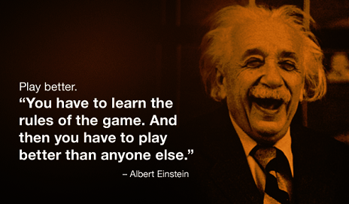
“Non-Traditional Course Option”
Lessons Learned
Never mention “free” or “3 courses for the price of 1” while in front of Budget
Never try to explain the inner workings of a course to Budget, Registrar, Student Services, etc.
curiouskhatri.wordpress.com

Slide 11
How do we best assist Financial Aid and Veterans Affairs students’ needs?
DSMA0399 is a 3 semester hour course with a set start date and end date – FA and VA is happy.
Why it is an NCBO:
Curriculum based on non-mastered concepts only (rewarded for mastery)
Self-Paced with instructor guidance
Option to complete up to 3 levels (Pre-Algebra, Beginning Algebra, Intermediate Algebra)

Slide 12
How does Registrar denote completion of each level?
  In Datatel we created an internal test. (3 line items, 1 for each level)
  After final exam completed, we enter the test score for that level.
  Above 70 awards credit for that course, and student can register for next level, the next term.

Slide 13

How do we get students enrolled?
First – Get the Word Out
CTC Website
Facebook
Brochures
Attend Student Success Workshop
Attend New Student Orientation
Share with faculty
Share with counselors
Word of Mouth!!!
peterfaur.com

Slide 14
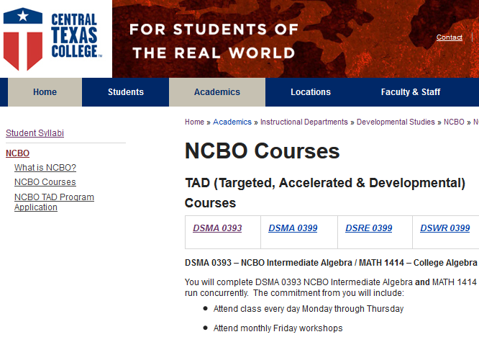
How do we get students enrolled?
Second – Application Process
CTC Website contains:
NCBO Definition
Course Descriptions
Course Times
Application
http://www.ctcd.edu/ncbo/

Slide 15
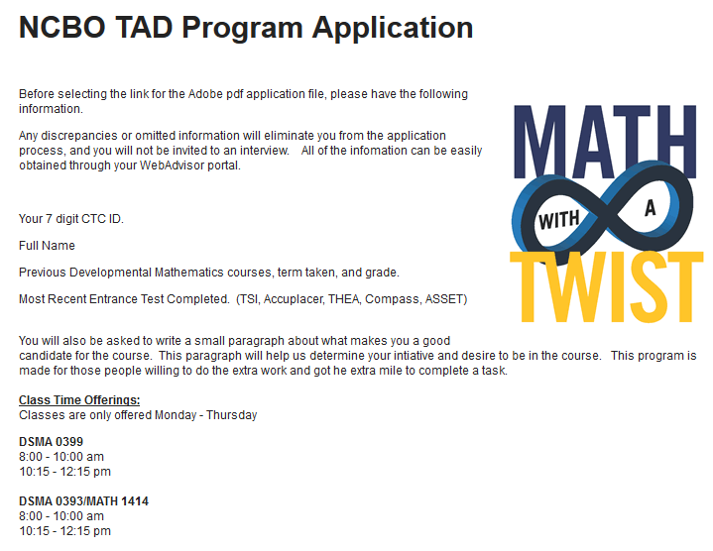
How do we get students enrolled?
Application Process (Continued)

Slide 16
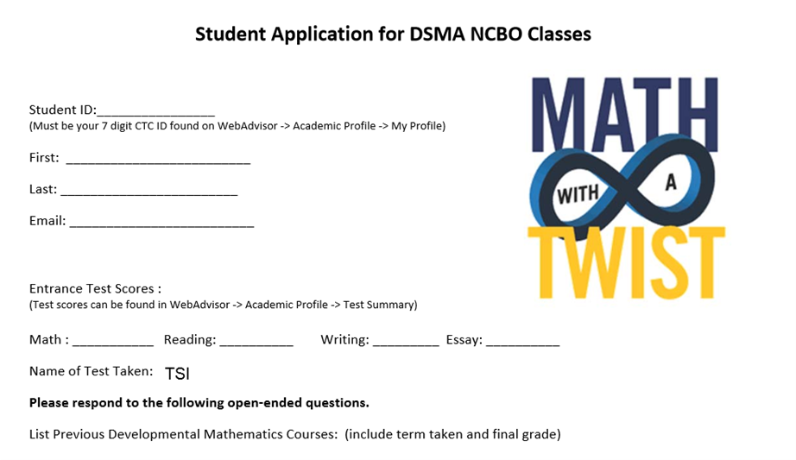
How do we get students enrolled?
Application Process (Continued)

Slide 17
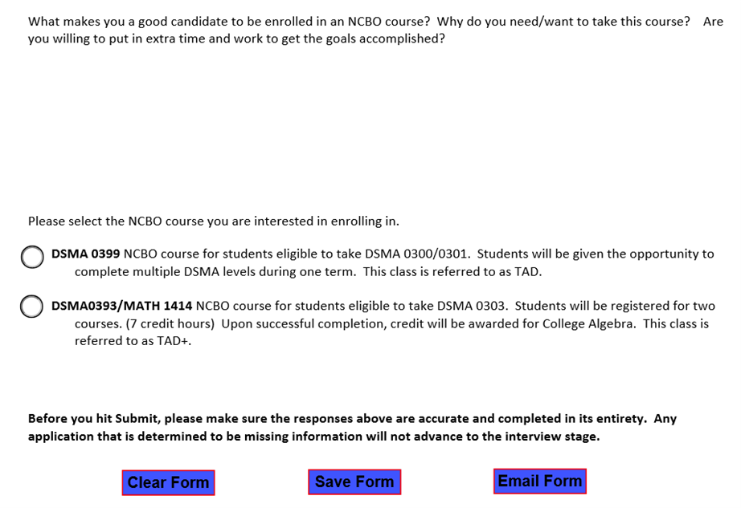
How do we get students enrolled?
Application Process (Continued)

Slide 18

How do we get students enrolled?
Interview Process
Students must complete prior to enrollment:
Submit complete application
Attend informational Interview Session
Sign Instructional Contract
Process demonstrates
dedication of students
plus enforces expectations
mysimplerestaurant.com

Slide 19
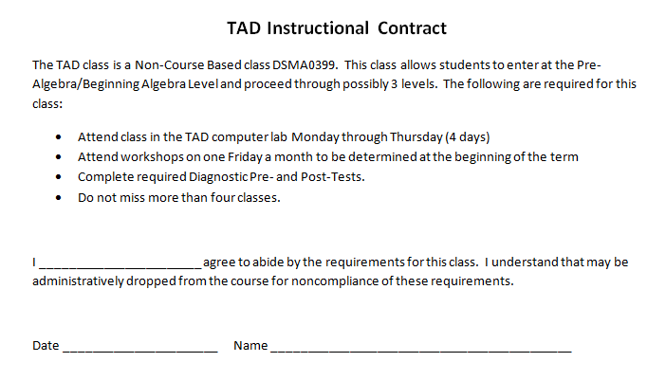
How do we get students enrolled?
Interview Process (Continued)

Slide 20
Challenges
Application Verification Process – In Progress
  Test scores and prior courses must be checked manually through DataTel.
  Data is checked to see if other options are better for a student.

Slide 21
Where can we find a space for a lab? How do we pay for the lab?
Do you have a space that is being under-utilized?
What does your institution do with out of warranty computers?
Get dirty – Dig in warehouse for old class desks/chairs.
Use adjuncts to man lab till new position can be created.

Slide 22
Challenges
Expansion Growth (facilities, staff, money) In Progress
  Room is at capacity with 58 student computers.
  Lab is shared with all NCBO classes/interventions

Slide 23
Basic Definition of TAD – started to come together by now
Students are provided with the opportunity to master the concepts needed to proceed to the next developmental/college course by working at their own pace and learning style in a targeted instructional contract.
Students complete up to three levels of Developmental Mathematics -- Pre-, Beginning, and Intermediate Algebra in one semester.

Slide 24
What should we use for curriculum, software, instructional materials?
Our initial thoughts:
Use what you are used to
  Martin-Gay curriculum
  My Labs products
Don’t want students to have to pay for up to three books/access codes
  For the pilot -> offer for free
Need Mastery Learning

Slide 25

Initial Solution for Quick Turnaround
Use MyMathTest:
Free to students
Covers 3 levels
Good resources
Customization of quizzes
Matches current curriculum

Slide 26

Final Solution
Use MyMathLab
Martin-Gay 3 level book
Only need one access code
More options for design of quizzes
Homework built from mastery on quizzes

Slide 27
First Few Days of Class
1st Day
Take the Pre-Algebra Diagnostic
Instructors create individual instructional maps for scores < 70%
2nd Day
Students who passed Diagnostic take the Beginning Algebra Diagnostic
Instructors meet individually to explain maps
Instructors create individual instructional maps for Beginning Algebra students

Slide 28
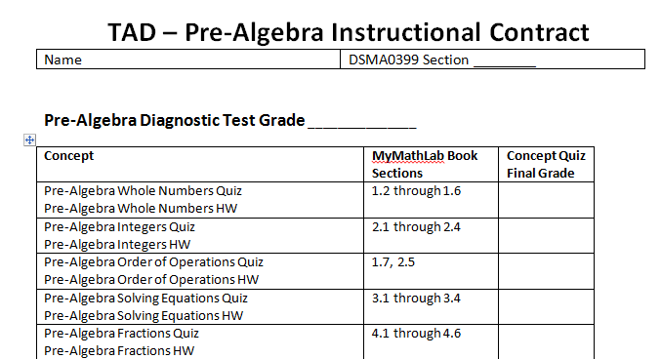
Instructional Contract Sample

Slide 29
Conquering the Map
For each concept, students take an initial quiz that builds a homework based on mastery.
Next, student studies using homework, “Help Me Solve This”, videos, individual help in lab, and mini workshops
Finally, the student retakes the quiz. Once they score a 70% or higher, they may move on to the next concept.
Many students choose to retake the quiz for an even higher
grade – Hence responsibility for learning!

Slide 30
Grading
Students must pass the Final Exam with > 70% to receive credit.
The quiz/homework grades are only used to proceed to the next concept.
Once the student has passed the Pre-Algebra Final Exam, they have passed the course – the next level is a bonus if passed.

Slide 31
Physical Set Up of Class
Students in lab Monday thru Thursday for 1 hour and 20 minutes per day.
Class times are set; however, some flexibility is allowed.
Mandatory workshops are held once a month on Fridays -- topics include Learning Styles/Personality Workshop by CTC Mental Health Department, Presentation by CTC Business Team ENACTUS, etc.

Slide 32

Individualized Help
With the NCBO program, the student can get individualized help if needed – The program stresses that the students must find the way that "works for their brain”.
imgur.com/gallery/LX5MNG2

Slide 33
Self Discovery
Self Discovery/credit for mastered concepts – Students appreciate being rewarded for what they already know.
"This course is self-paced, to an extent, and I like the freedom to work faster or slower in order to really understand the concepts presented.“ DSMA0399 Student

Slide 34

Individual Learning Styles
After completing surveys, students are able to choose resources to be successful. – Mandatory workshop with licensed social worker over survey results.
runway2013accessfashionbusiness.myblog.arts.ac.uk/2014/03/09/vark-learning-styles-theories/

Slide 35
Student Comment:
"I feel like I learn more quickly if I'm not put under so much pressure. When I was taking 301 I felt pressured in that class and felt like I was not learning well and what I did learn I was not able to remember for the test. While in the NCBO 0399 course I felt A LOT less pressured and relaxed, so the pressure that I had before was no longer there. I am more than willing to give more of my time for this class as well as effort. I really feel like this is no longer a course I want to be in, but one that I need to be in."
-- A student applying to be in Paired Class.

Slide 36

The Team Approach
The Team consists of four faculty, a FT TA (qualified to teach all levels), and 2 PT tutors.
The students benefit from different explanations/techniques to solve the same problem. - The current team has three Mathematicians, an Engineer, and a Scientist.
imgur.com

Slide 37
The Team Approach
The team works well together and shares the common goal of pursuing student confidence, responsibility, and success.
The instructors "take time showing me all kinds of ways to do one problem until I get to a way I can do it on my own and fell confident... It is a rare thing to have teachers who devote so much time and care to make sure you are where you want to be in class. “ – Student Comment

Slide 38
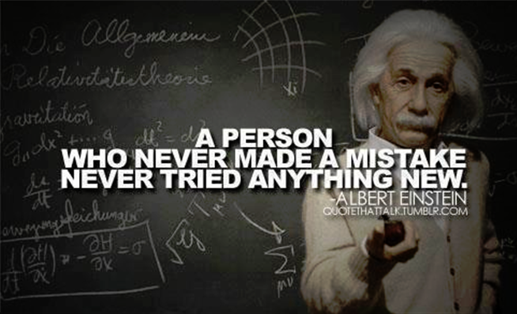
Team Approach
Faculty members serve as a mentor and ‘cheerleader’ pushing the student to succeed -- This philosophy handles the disconnect often found between faculty/student expectations.

Slide 39
Team Approach
The team uses compassion, tough love, laughter, and sarcasm to allow students to feel at ease in the class/lab. – This strategy leads to increase of student enthusiasm and confidence.
The personality of the team sets a standard and leads by example. "We love Math" is the mantra. - This program begins to break down the walls of intimidation around faculty.

Slide 40


Lesson Learned
Similar success with new faculty -> Faculty must be enthusiastic for students to succeed. Pair new faculty with existing faculty for on-the-job training.
“Uninspired” faculty
-Need Not Apply.

Slide 41
Community Environment
The lab houses students from Pre-Algebra to College Algebra -- students are at all different levels within each class. - Students continue to attend to get assistance in other classes… even some that are not mathematics.
The National Study of Developmental Education found that programs integrating classrooms and labs had significantly higher pass rates in developmental education (Boylan, Bonham, Claxton, and Bliss, 1992). Integration does not constitute providing labs to classroom students; but, rather concerns a target effort to link the classroom to the lab and vice versa. These efforts include directly related activities, instructors dedicating time to the lab, required time in the lab for students, close proximity of the lab and classroom. (Boylan, 2002).

Slide 42

Community Environment
“Noisy”, relaxed environment – even supply candy!
The team does not allow judging, condescending remarks/sounds, or negativity amongst peers.

Slide 43
Student Comments:
"I greatly benefit from having a "noisy" lab where I can ask questions and have one on one help if needed. Math is a tough subject for me..." With the help of the instructors, "I was able to comprehend what I was learning, not only in class but in the lab. They all gave me the tools I need to be successful and spent the extra time with me to break things down to where I could understand Math.

Slide 44

Why it works!
Picsndquotes.com

Slide 45
DSMA 0399 Data
Data Time frame: Spr13 – Fal14
 | DSMA 0399
Number of students | 317 **
Complete 0 levels | 39 (incl. drop/withdraws)
Complete 1 level | 94
Complete 2 levels | 159
Complete all 3 levels | 26
** Data for 1st time in course.
58.4% complete multiple levels.

Slide 46
College Algebra Pass Rates
 | 0399 to 1414 | 0393 to 1414
Number of students | 137 | 330
Pass Rate | 91.2 % | 93.6 %
Withdraw/Drop Rate | 3.6 % | 2.4 %
** 109 DSMA 0399 students also completed DSMA 0393/MATH 1414.

Slide 47
Traditional Course Pass Rate
 | DSMA 0300 | DSMA 0301 | DSMA 0303 | MATH 1414
Number of Students | 1535 | 1172 | 874 | 2070
Pass Rate | 42.4 % | 43.7 % | 44.7 % | 58.3 %
Withdraw/Drop Rate | 31.3 % | 24.1 % | 33.5 % | 21.9 %
39 Students successfully completed all three DSMA levels.
11 students completed DSMA 0300 through MATH 1414.
*** This comes from the 900 students that started DSMA 0300, lowest level in the CY 2013. These students would have 4 terms to complete all 4 courses.

Slide 48
Test Scores Vs. Levels Completed
Placement Based On TSI Tests | Total | Developmental Levels Completed |  |  |  |  | Completed College Algebra
 |  | 1 | 2 | 3 | 0 | Drop | Enrolled | Passed
Pre-Algebra | 263 | 76 | 134 | 20 | 2 | 31 | 117 | 109
Beginning Algebra | 38 | 11 | 19 | 5 | 0 | 3 | 15 | 11
Intermediate Algebra | 2 | - | 1 | 1 | - | - | 1 | 1
College Algebra | 1 | - | 1 | - | - | - | - | -
No Scores | 13 | 7 | 4 | - | - | 2 | 4 | 4
Test scores do not show student potential, if given opportunities to thrive.

Slide 49
Prior Pre-Algebra Vs. Levels Completed
Prior Dev Math in the Classroom | Total | Developmental Levels Completed |  |  |  |  | Completed College Algebra
 |  | 1 | 2 | 3 | 0 | Drop | Enrolled | Passed
Pre-Algebra - 1 Semester | 121 | 32 | 66 | 12 | 1 | 10 | 59 | 57
Pre-Algebra - 2 Semesters | 16 | 8 | 4 | 4 | - | 4 | 5 | 5
Pre-Algebra - 3 Semesters | 5 | 1 | 4 | - | - | 4 | 3 | 2
64% passed
more than 1
47% passed
College Alg
* 83 passed Pre-Algebra in the traditional course prior to NCBO.
Data shows lack of retention from previous traditional courses. (Aaron)

Slide 50
Student Comments
"I have always wanted to understand math, but until the DSMA 0399 class I had always felt that it was impossible.“
- quote from student

Slide 51

Overall Lesson Learned
Never show you can move a mountain with just a shovel. -> Next time they will expect you to use your bare hands.

Slide 52
NCBO Program
Three Options:
TAD (DSMA 0399 covers Pre-,
Beginning, Intermediate Algebra)
2) TAD Plus (DSMA 0393 / MATH 1414
paired Intermediate/College Algebra)
3) TAD Bit (extender initiative)
http://www.ctcd.edu/ncbo

Slide 53
TAD Plus -- NCBO Intermediate Algebra/College Algebra
Students can complete College Algebra with Intermediate Algebra taught in a Just-In-Time format.
The curriculum, rigor, quizzes/tests coincide with CTC Math Department's requirements.
Instructors team teach; therefore, one instructor is always available during class to help individual students.

Slide 54

TAD Plus – Paired Class
Physical Setup of Classroom
Attend class four days a week (80 min/day)
Mandatory two hours a week in lab with a TA and tutor(s).
Lectures recorded on Mimio Smartboard equipment and are posted on MyLabsPlus
Monthly mandatory workshops
www.mimio.com

Slide 55
Engages/Enhances Interest in Math with Relevance

Slide 56


Lesson Learned – TAD Plus
For paired model, carefully screen transfer credit/credit from other campuses -> Discussing standardizing eligible students.

Slide 57
Challenges – TAD Plus
Application Verification Process – In Progress
  While lengthy, this process is imperative to the success of the student.
  Confirmation students are eligible for the Intermediate Algebra course.
  Different type of student, willing to complete the application.

Slide 58
TAD BIT
Two week extension course offered at the end of the term to students that failed the course with a grade in the 60s. Consideration is given to those that have overall average in the 50s if passing prior to final examination.
21 / 30 students were successful.
4 students were allowed into 393/1414 using holistic counseling.
  3 were successful
  1 is currently enrolled.

Slide 59
What’s next ??
Implementation of pilot for DSMA 0391
  16 week course combining Pre- and Beginning Algebra
Attempt models in the Reading/Writing courses
Creation of classes for ABE Levels 1 – 4 based in TSIA scores.
Scaling – House Bill 5 and Satellite Campuses
Redesigning the Pre-Assessment Activity
Pilot DSMA 0399 in the online format.
Overhaul all Dev Studies labs to enhance experience for regular classroom students. – Construction and re-staffing.

Slide 60

Albert Enstein
onlygags.com

Slide 61



