Slide 1
Just Breathe
February
2022
Avoiding Burnout

Slide 2
Stressors

Slide 3
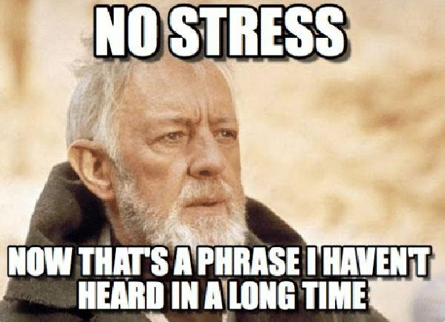
Stressors can be
Conscious or Subconscious

Slide 4
Common Conscious Stressors
 | You | Others | Society
Medical | Yours | Loved ones | Global
Not in Control | Self control | Controlling others | Controlling society
Unreal Expectations | I should | You should | We all should
Personal | Relationships | Family | Work
Financial | Just you | Dependents | Taxes et al
Consider what stresses you out

Slide 5
Exercise #1

Slide 6
Rate your stress

Slide 7
Do what’s in your power

Slide 8
What CAN you Control?
Put a check by the stressors you can control

Slide 9
Things you can control
To an extent
 | You | Others | Society
Medical | Yours | Loved ones | Global
Not in Control | Self control | Controlling others | Controlling society
Unreal Expectations | I should | You should | We all should
Personal | Relationships | Family | Work
Financial | Just you | Dependents | Taxes et al
Devise a plan and stick to it

Slide 10
Ideas
Yourself
Others (if possible)
Society
Plan Practice Reward
Consider the part you played
Talk
Admit
Apologize Compromise
Resolve
Let it go
Speak up
Vote
Get involved

Slide 12
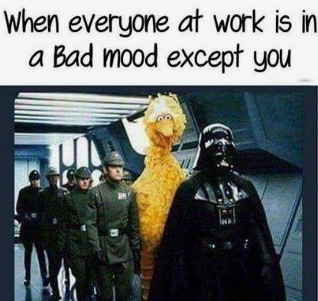
We aren’t always aware of our stress

Slide 13
When you just can’t let it go
Subconscious
You obsess
You gossip
You worry
You react as though it is the truth
You give up and no longer care
You quit

Slide 14
Possible Causes
Knee Jerk Reactions
Triggers- you feel helpless
Habit – What you were taught
Don’t cry – be tough
Don’t trust other cultures
Codependency
Past Experiences
Misunderstanding in communication
Old tapes

Slide 15
What triggers you?
Habit – family tradition
Includes Codependency

Slide 16
Triggers are stuck ages
What age did you get stuck?
Ridiculed by your first boss Age 18
Ignored Age 13
Told you’re stupid Age 5
Bullied Age 7
Abandoned Age 3

Slide 17
Triggers
Write down your triggers

Slide 18
Habit
If you hear yourself say “We’ve always done it this way”
“My family expects it”
“I can’t change it”
Then ask yourself “Can I truly change this?”

Slide 19
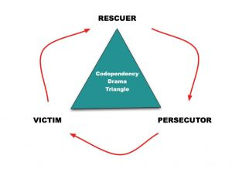
Codependency is habit
You have a false sense of needing it

Slide 20
Past Experiences
When you say, “It happened then, so it will probably happen again.”

Slide 21
Out communication
Misunderstandings in Communication
In Communication
Verbal
Non-verbal
Written
Listening
Visual
Verbal
Non-verbal
Written
Listening
Visual

Slide 22
Old Tapes
I’m dumb
I’m irresponsible
I’m not worthy

Slide 23
Ways to let go
Understand your triggers
Reframe
Talk it through
Walk in other’s shoes
Do something positive
Be good to yourself
Grieve
Consider your subconscious

Slide 24
Reframing
Could others also be stuck in an age?
Consider this when gossiping
Or when angry
Or when you believe someone did something to you deliberately

Slide 25
If you know someone is triggered and there’s no hope of them having self awareness, what can you do?
Distance yourself, but stay professional if a co-worker
Remember, it’s not about you

Slide 26
Are you sabotaging yourself?

Slide 27
Do what makes you happy

Slide 28
Stress can be from having to be what you are not
Take an Introvert/Extrovert test
https://www.psychologytoday.com/us/tests/personality/extroversion-introversion-test

Slide 29
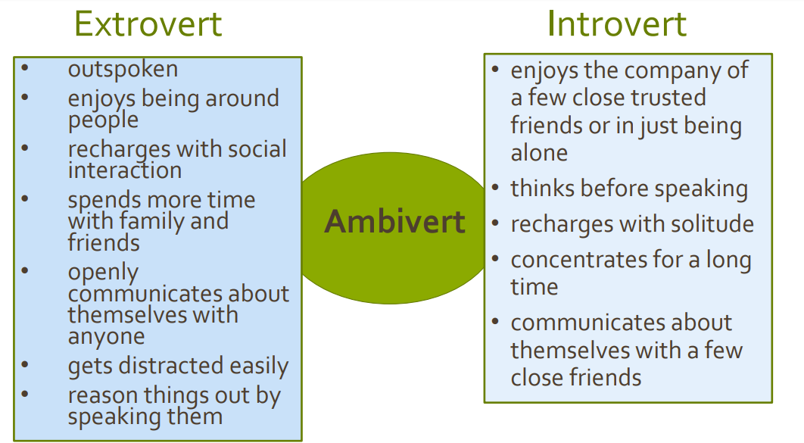
Why type are you?

Slide 30
Symptoms of Burnout
If you say any of the following…..
I have to
I’m tired
I don’t care
I don’t have enough time
I can’t relax

Slide 32
Stress Relief
Tapping
Music
Meditation while working
Exercise or just going for a walk
Playing with pets and children
Mini vacations (which can include window shopping, binge watching shows, doing puzzles and watching birds)
Learn something new
Laugh!

Slide 33
Thank You!
Cindy Oser
You can always email me at cynthia.oser@ctcd.edu

